Slide 1
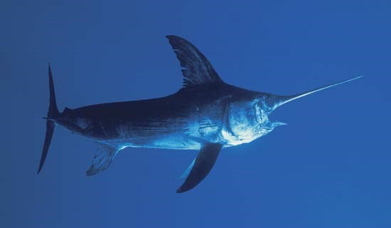
North Pacific Swordfish 2023 Benchmark Stock Assessment
Hirotaka Ijima, BILLWG Chair
Michelle Sculley, lead modeler

Slide 2
Overview
Review of the 2018 Benchmark Stock Assessment
2023 Assessment Data and Model
NP Swordfis Life History Information
Fishery Definitions and Selectivity Modeling
Catch, Standardized CPUE, and Size Composition Data
Likelihood Components and Data Weighting
Model Diagnostics
2023 Assessment Results
Stock Status
Sensitivity Runs
Stock Projections

Slide 3
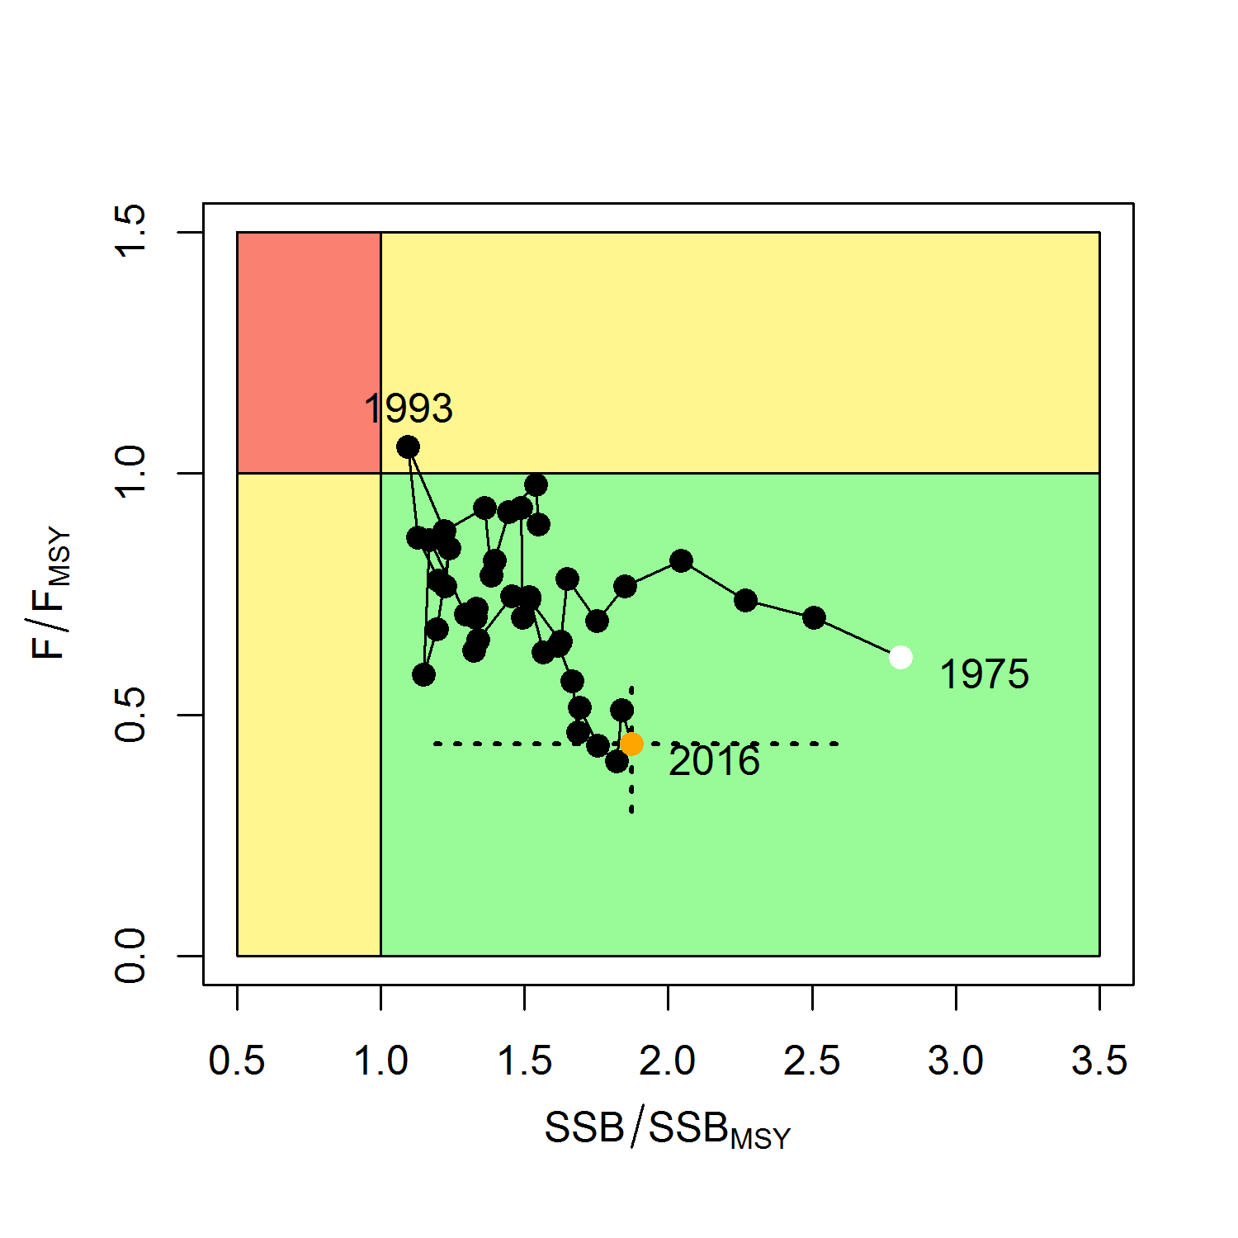
Overview of the 2018 Stock Assessment
2018 Stock Assessment Summary
Stock Synthesis 3.30 model (ISC 2018)
SSB₂₀₁₆ = 29,403 mt (87% above SSB_{MSY})
F₂₀₁₄₋₂₀₁₆ = 0.08 (47% below F_{MSY})
NP SWO was not experiencing overfishing and was not overfished relative to MSY-based reference points

Slide 4
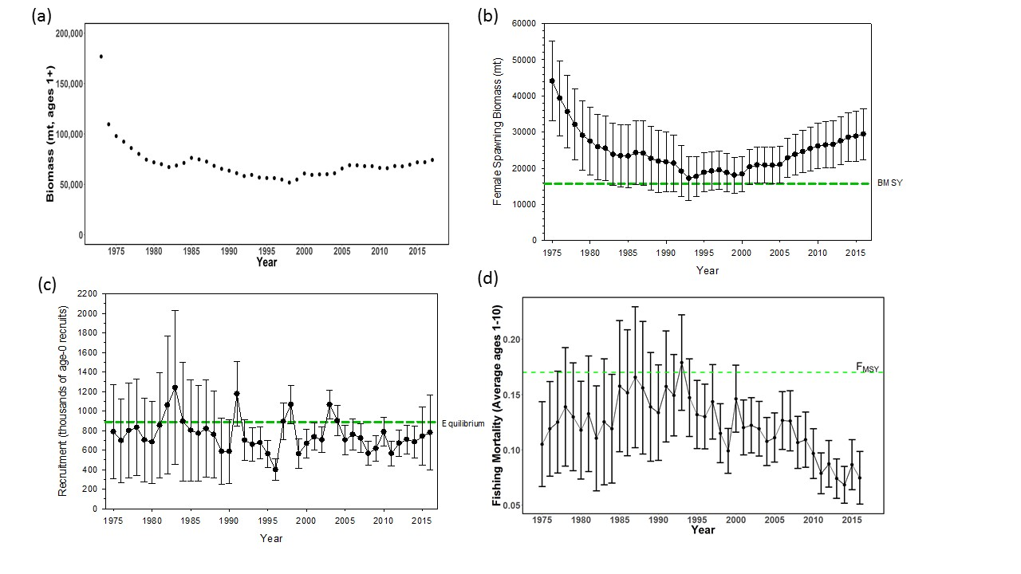
NP Swordfish Stock Status in 2018

Slide 5
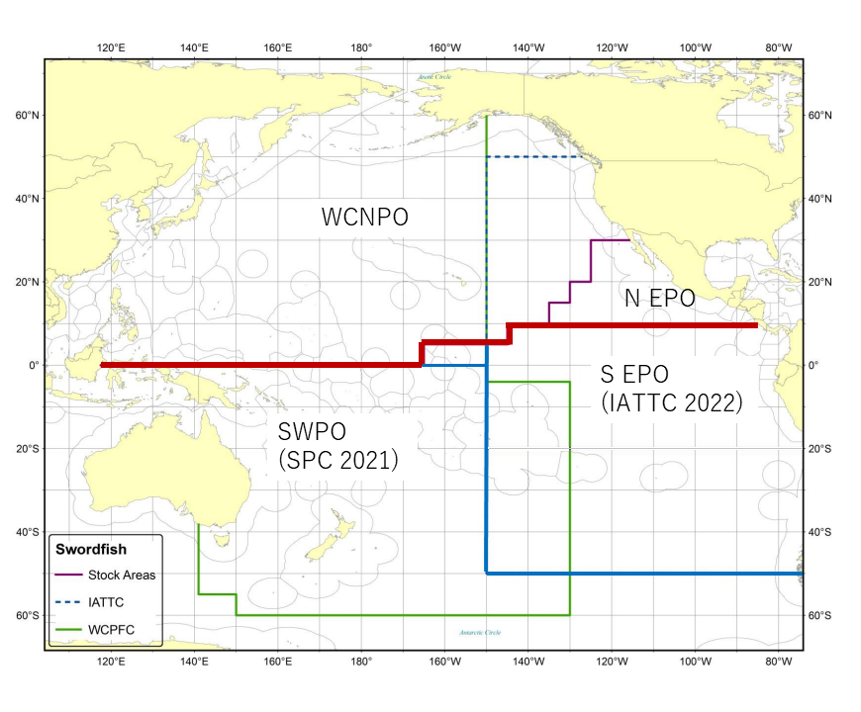
2023 NP SWO Modeling Changes
Stock structure is expanded to include the N EPO “triangle”
Using fleets-as-areas to account for stock structure
Fleet structure is consistent with 2018 assessment
Biological information is unchanged from 2018
2018 assessment

Slide 6
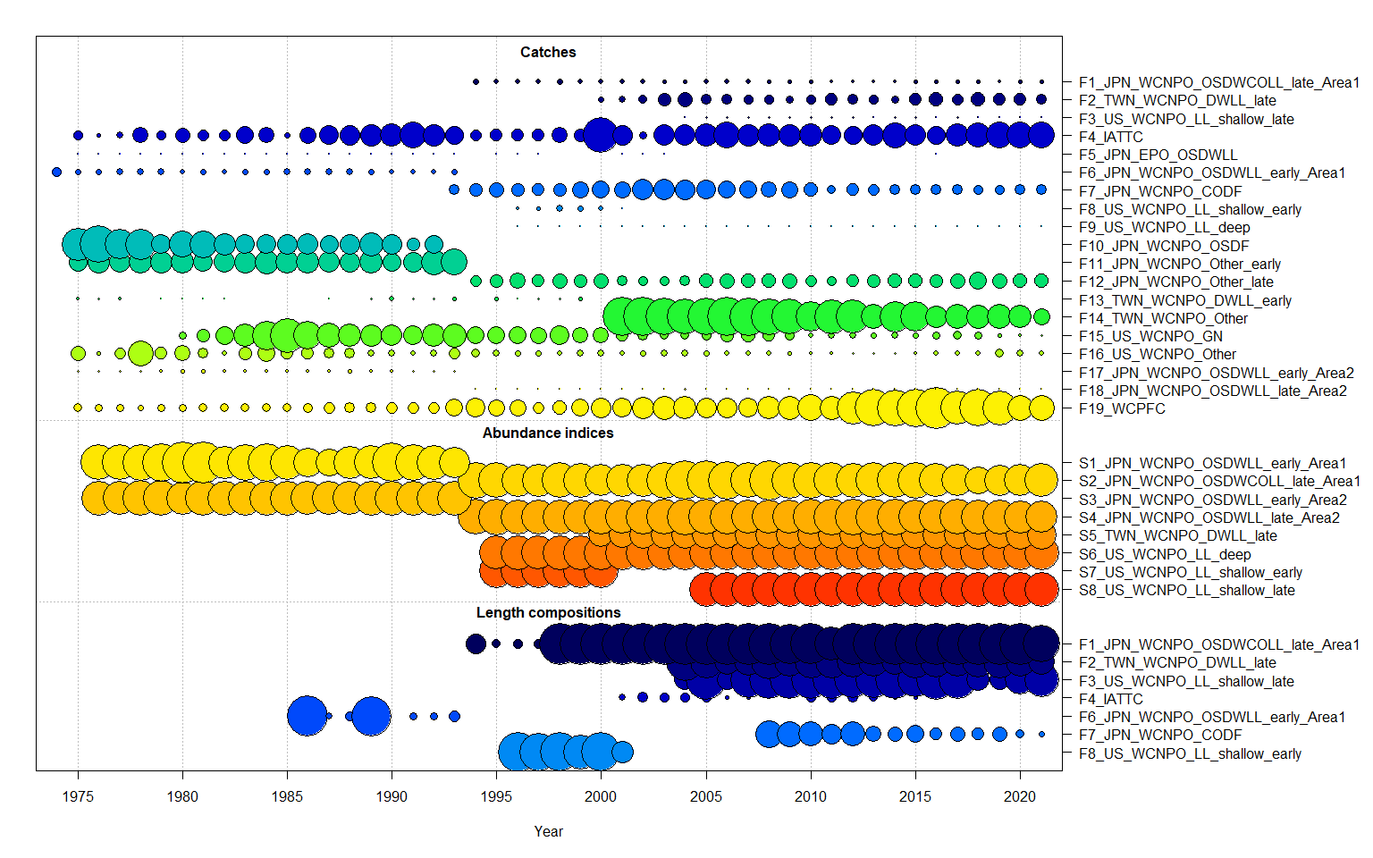
Fleet Structure
Catch Index | Abundance Index | Fleet Name | Time Period | Length Comp Used?
F1 | S1 - Y | JPN_WCNPO_OSDWCOLL_late_Area1 | 1994-2021 | Y
F2 | S5 - N | TWN_WCNPO_DWLL_late | 2000-2021 | Y
F3 | S8 - N | US_WCNPO_LL_shallow_late | 2004-2021 | Y
F4 | - | IATTC | 1975-2021 | Y
F5 | - | JPN_EPO_OSDWLL | 1975-2016 | N
F6 | S2 - Y | JPN_WCNPO_OSDWLL_early_Area1 | 1975-1993 | Y
F7 | - | JPN_WCNPO_CODF | 1993-2021 | Y
F8 | S7 - Y | US_WCNPO_LL_shallow_early | 1993-2001 | Y
F9 | S6 - Y | US_WCNPO_LL_deep | 1996-2021 | N
F10 | - | JPN_WCNPO_OSDF | 1975-1992 | -
F11 | - | JPN_WCNPO_Other_early | 1975-1993 | -
F12 | - | JPN_WCNPO_Other_late | 1994-2021 | -
F13 | - | TWN_WCNPO_DWLL_early | 1975-1999 | -
F14 | - | TWN_WCNPO_Other | 2001-2021 | -
F15 | - | US_WCNPO_GN | 1980-2021 | -
F16 | - | US_WCNPO_Other | 1975-2021 | -
F17 | S3 - Y | JPN_WCNPO_OSDWLL_early_Area2 | 1975-1993 | -
F18 | S4 - Y | JPN_WCNPO_OSDWLL_late_Area2 | 1994-2021 | -
F19 | - | WCPFC | 1975-2021 | -

Slide 7
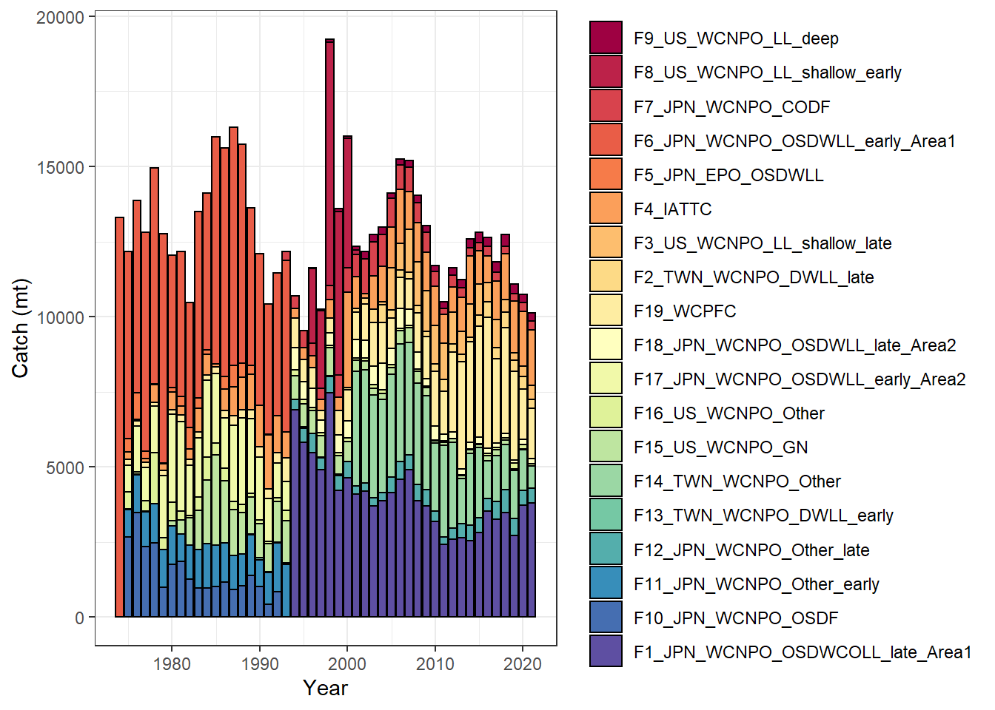
Catch By Country/RFMO and Region

Slide 8
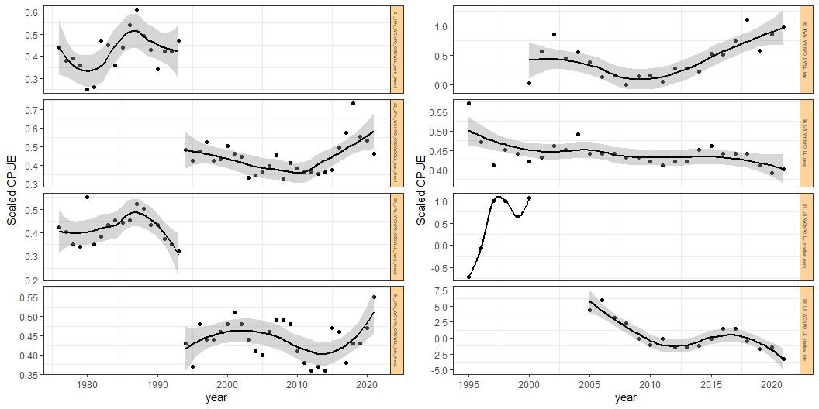
Standardized CPUE by fleet
S1_JPN_WCNPO_OSDWLL_Early_Area1
S5_TWN_WCNPO_DWLL_late
S2_JPN_WCNPO_OSDWLL_Late_Area1
S6_US_WCNPO_LL_Deep
S3_JPN_WCNPO_OSDWLL_Early_Area2
S7_US_WCNPO_LL_shallow_early
S4_JPN_WCNPO_OSDWLL_Late_Area2
S8_US_WCNPO_LL_shallow_late

Slide 9
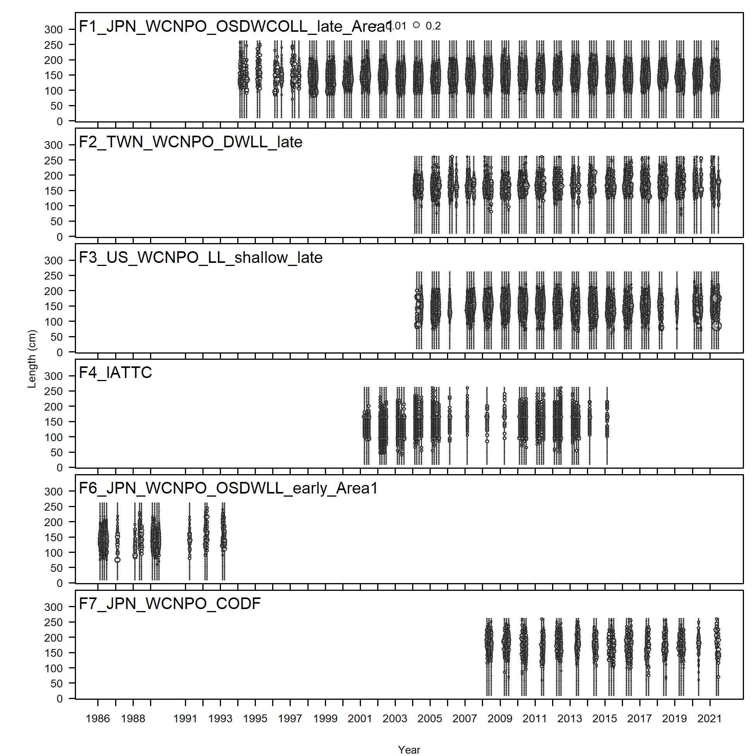
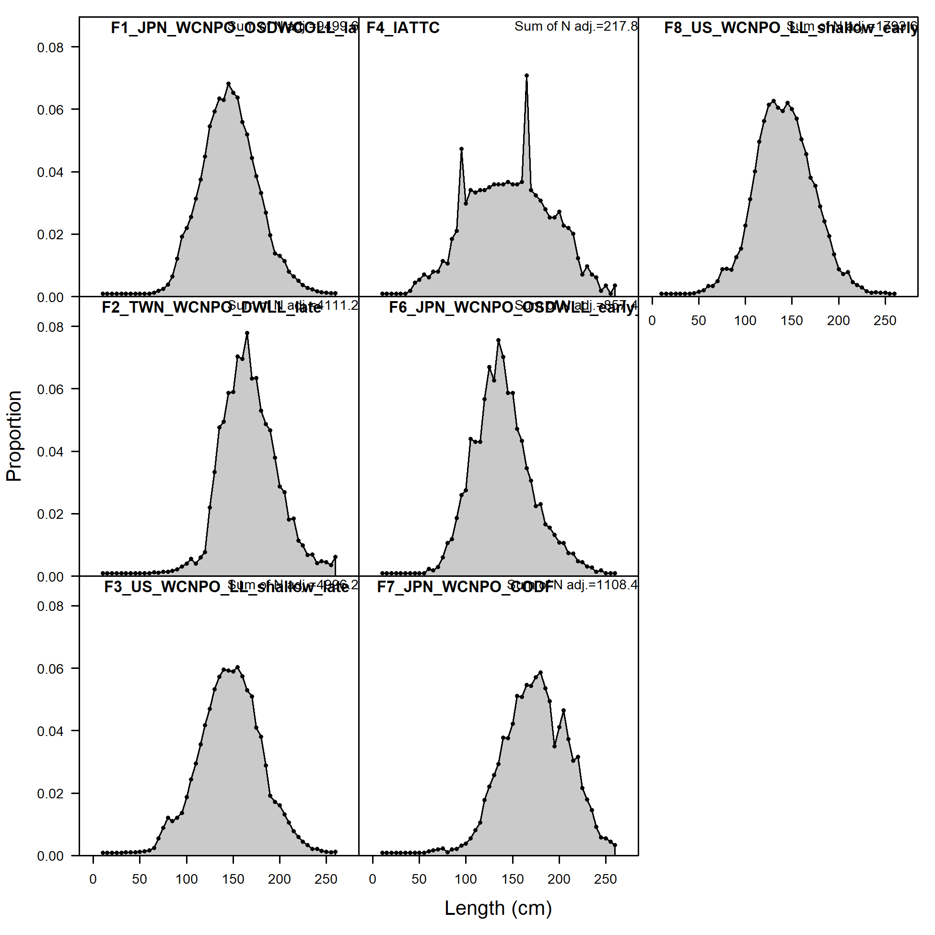
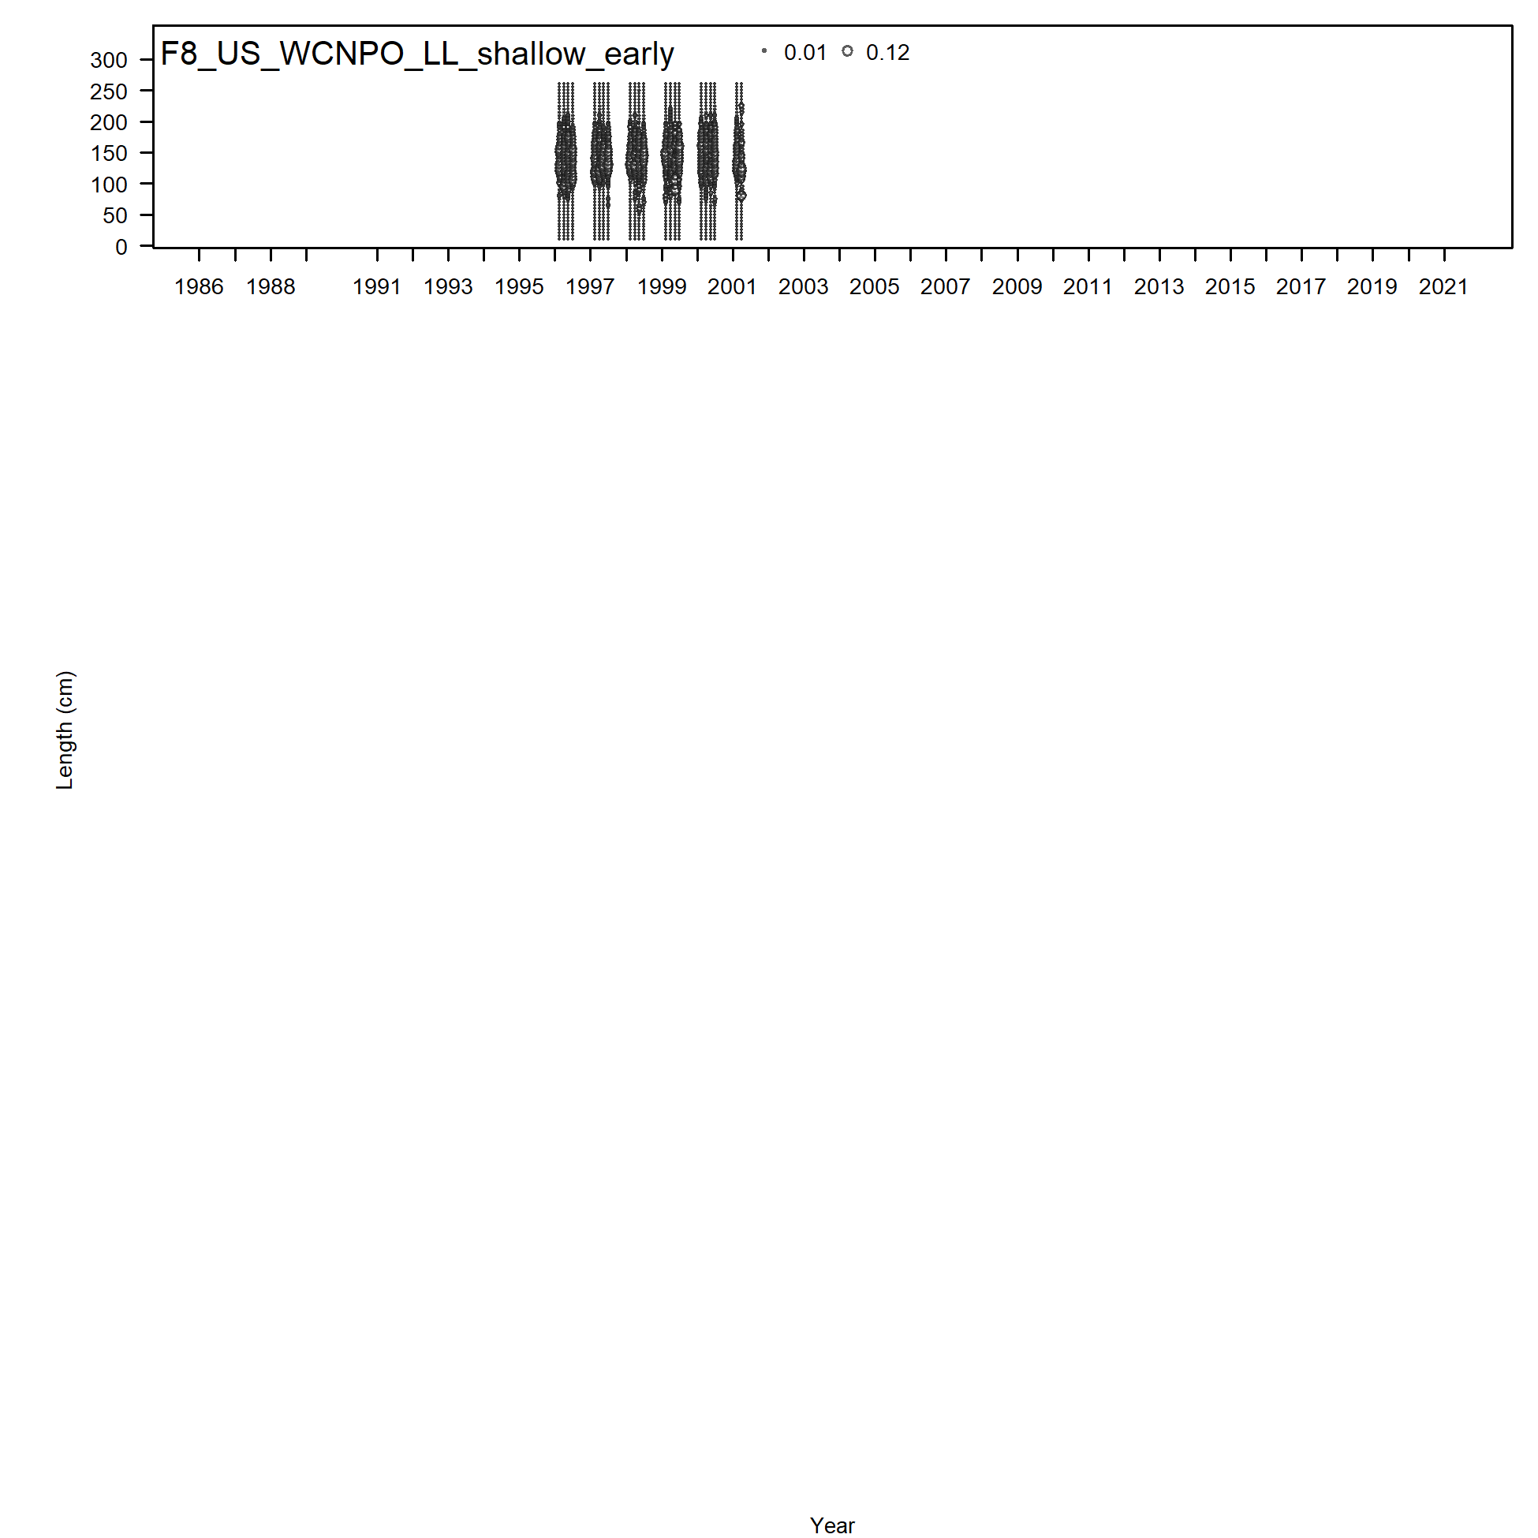
Size Composition Data by Fleet

Slide 10
Modeling approach
2023 benchmark assessment used the Stock Synthesis 3.30 assessment model in a maximum likelihood estimation framework with some parameter constraints for fishery selectivity parameters
The assessment covers almost the entire North Pacific, using a fleets-as-areas approach to account for the WCNPO and N EPO regions.
The N EPO region only contributed about ~10% of the total catch on average over the last 20 years
Stock projections were conducted for 2022-2031 using the deterministic forecasts through SS with 100 bootstraps for each scenario using the stock-recruitment curve.

Slide 11
Data Observation Model
Abundance Indices
Lognormal observation errors for abundance indices
log(SE) = sqrt(log(1+CV²)) for the individual CPUE standardizations
Values of log(SE) < 0.20 were rescaled to set log(SE) = 0.20
Size Composition Data
Multinomial observation errors for size composition data
Size compositions with fewer than 15 individuals measured were removed
Effective sample size was number of fish measured/10, with all year/quarters greater than 50 set to 50.

Slide 12
Estimation of Recruitment Deviations From Stock-Recruitment Curve
Recruitment was estimated during 1977-2020 (with bias adjustment) and used the expected recruitment value from the estimated stock-recruitment curve for 2020
Recruitment variability (σ_{R}, the standard deviation of log-recruitment) was fixed at σ_{R} = 0.6. Rescaling σ_{R} was not suggested by the model outputs.

Slide 13
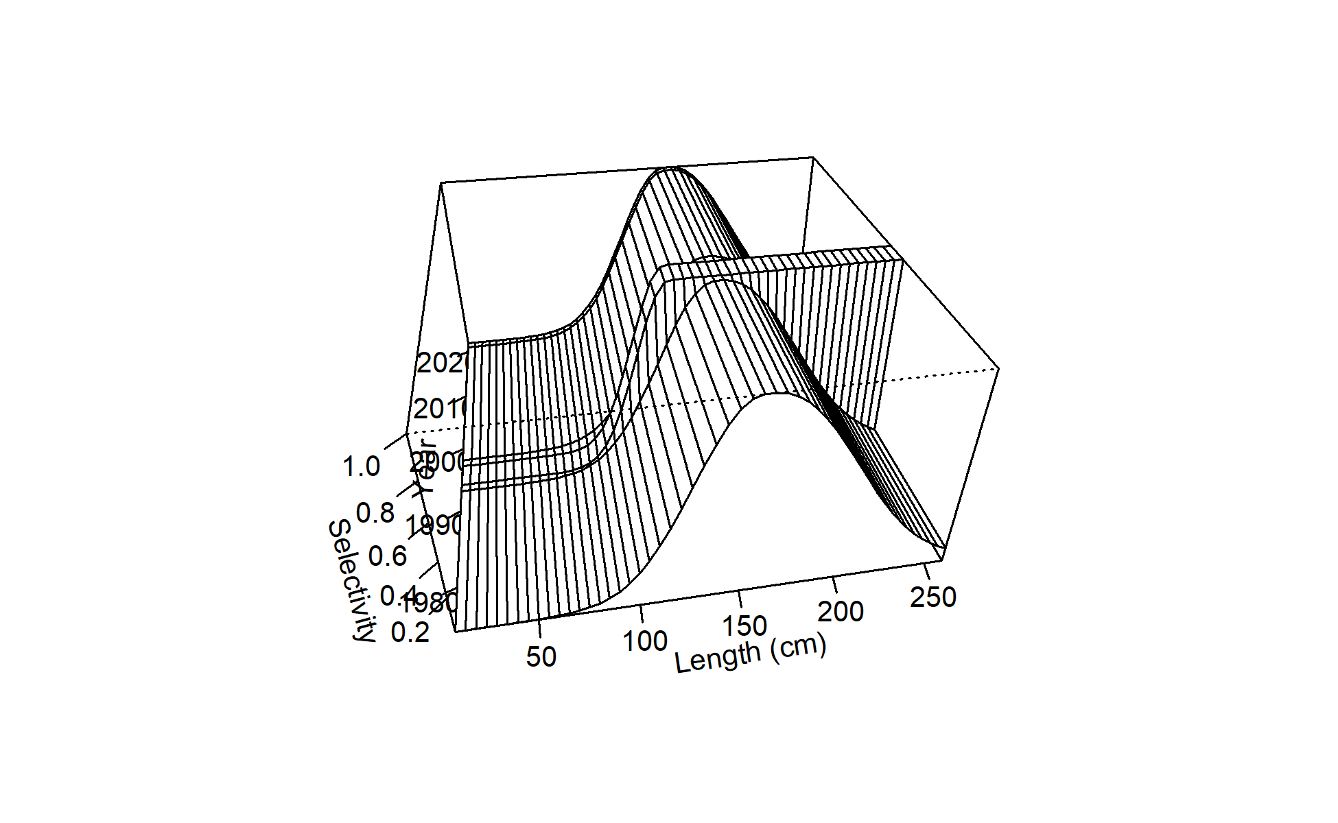
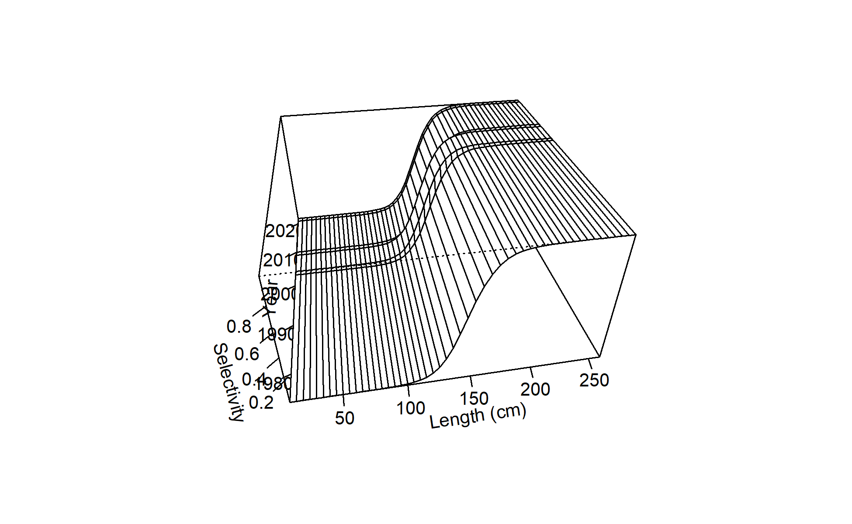
Time-varying Selectivity
F01 Japanese LL Area 1 Late
F02 Chinese Taipei LL late

Slide 14
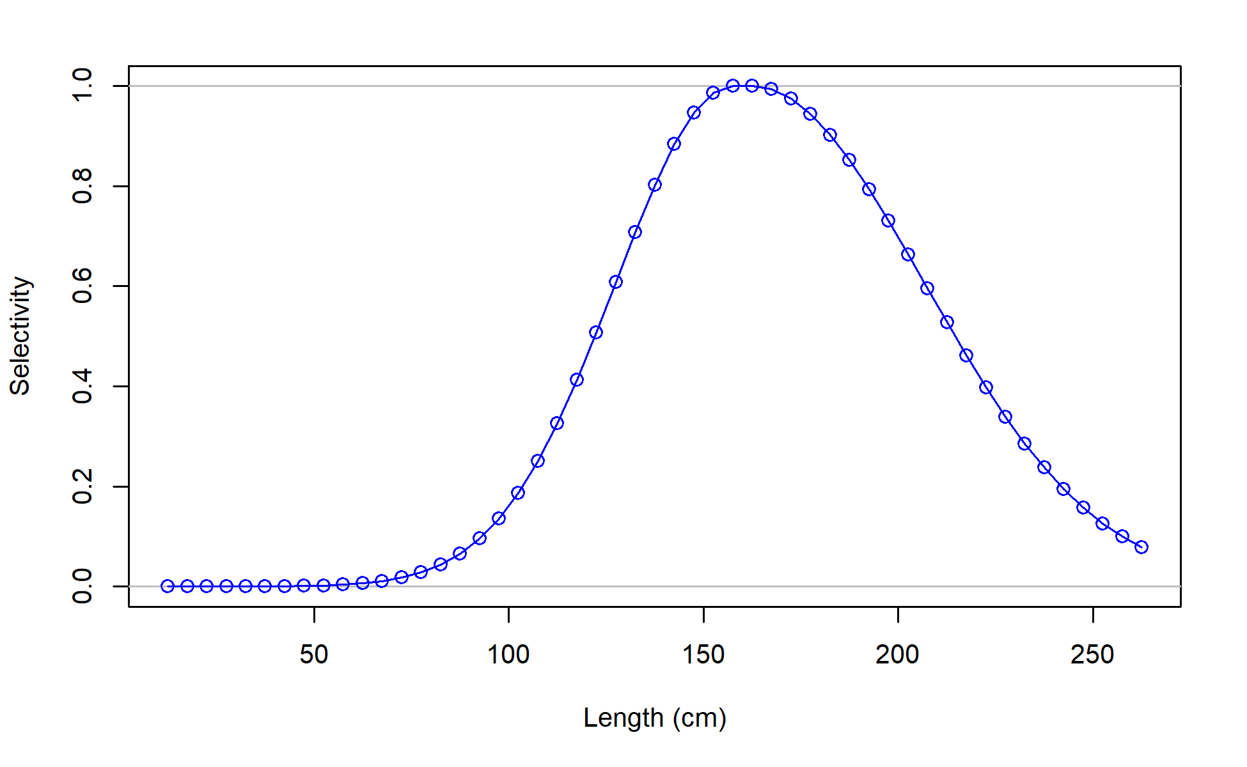
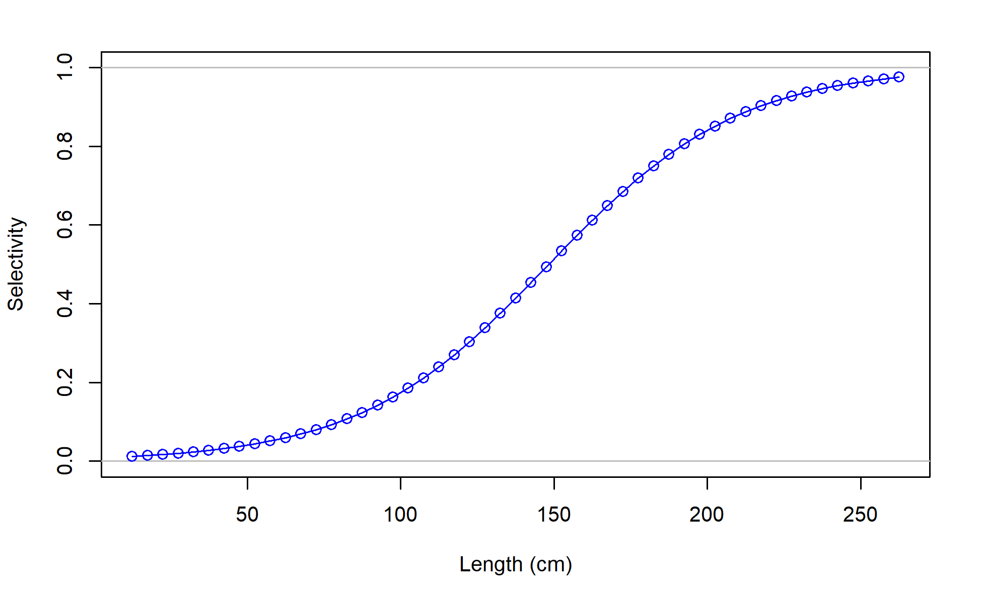
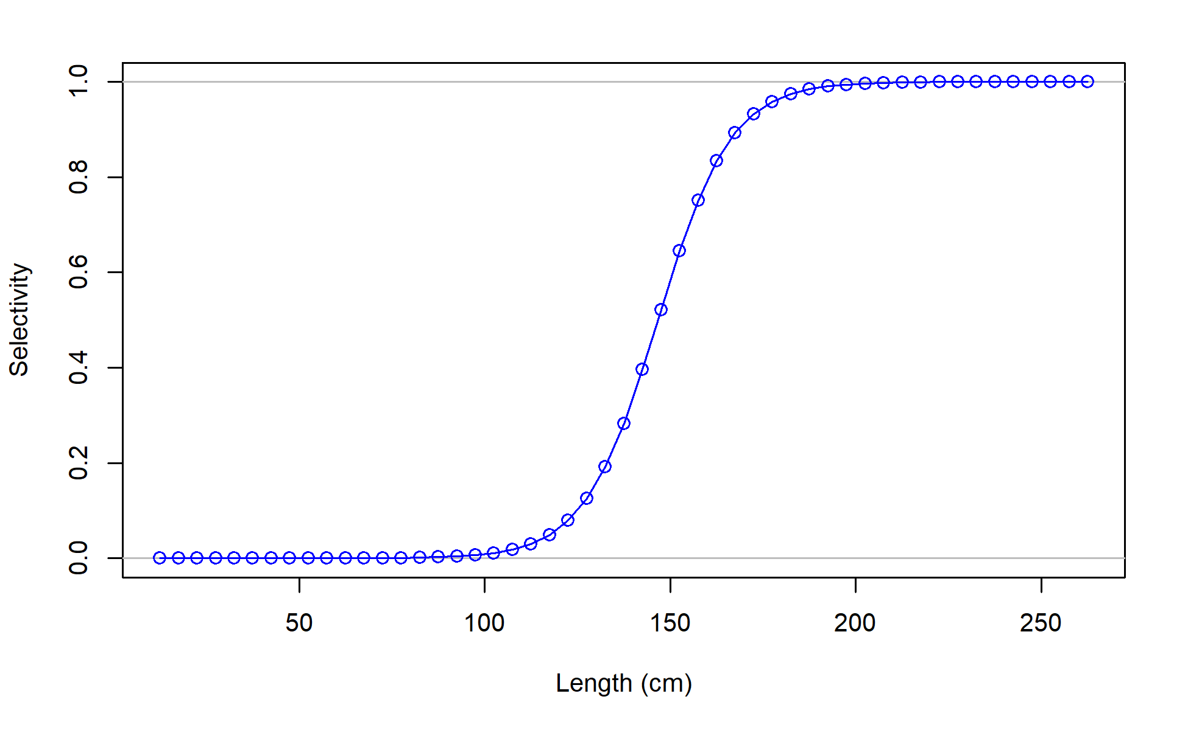
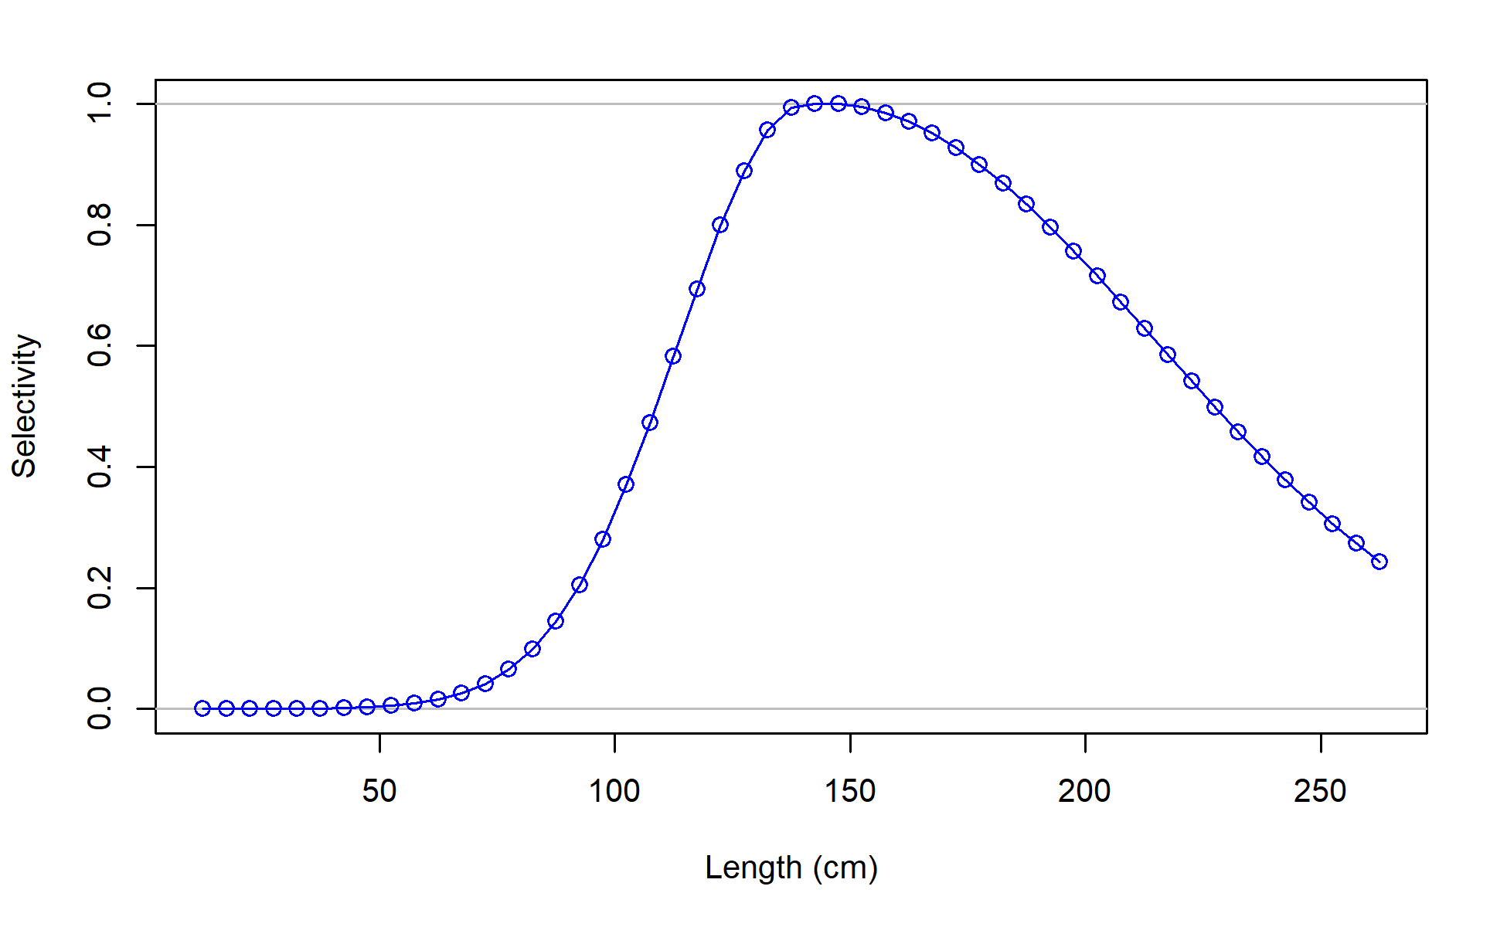
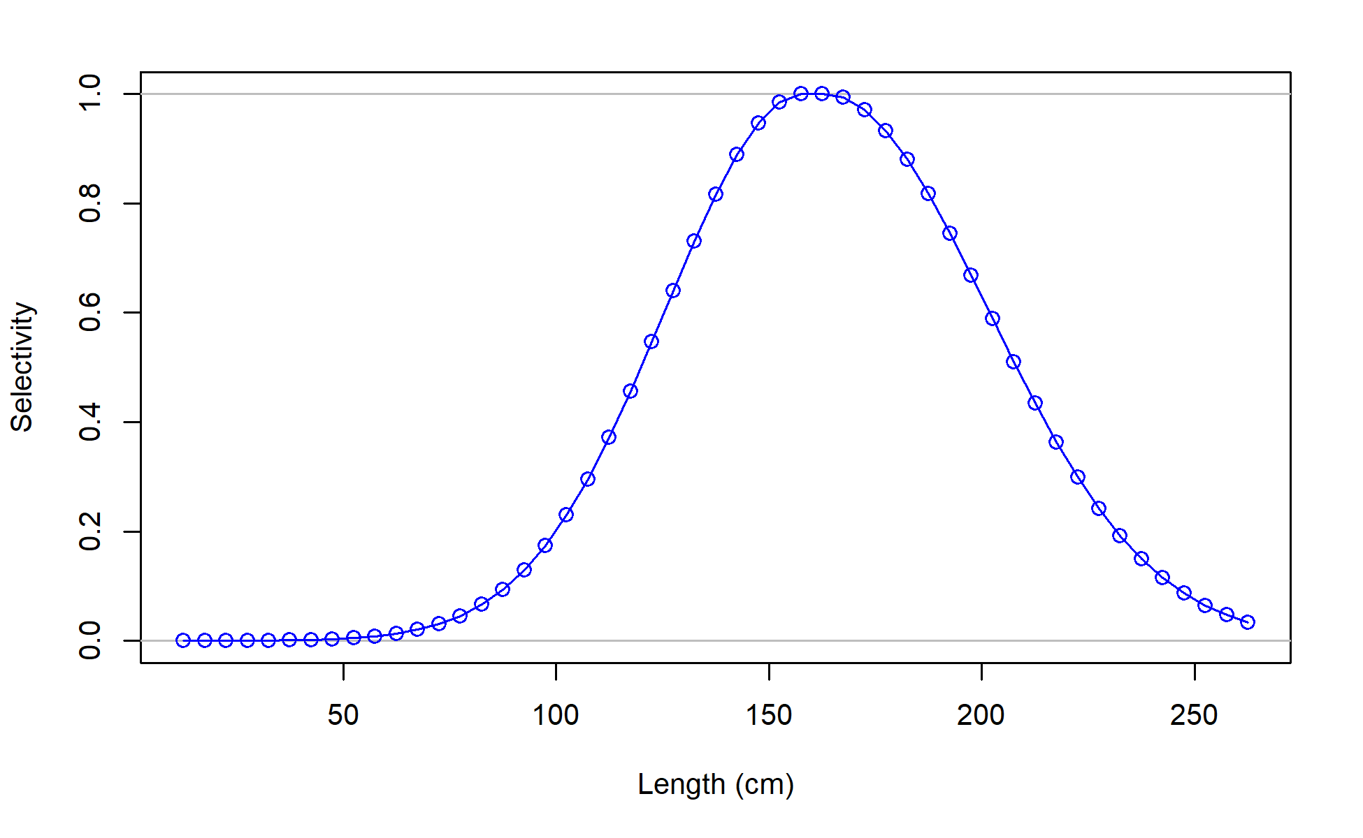
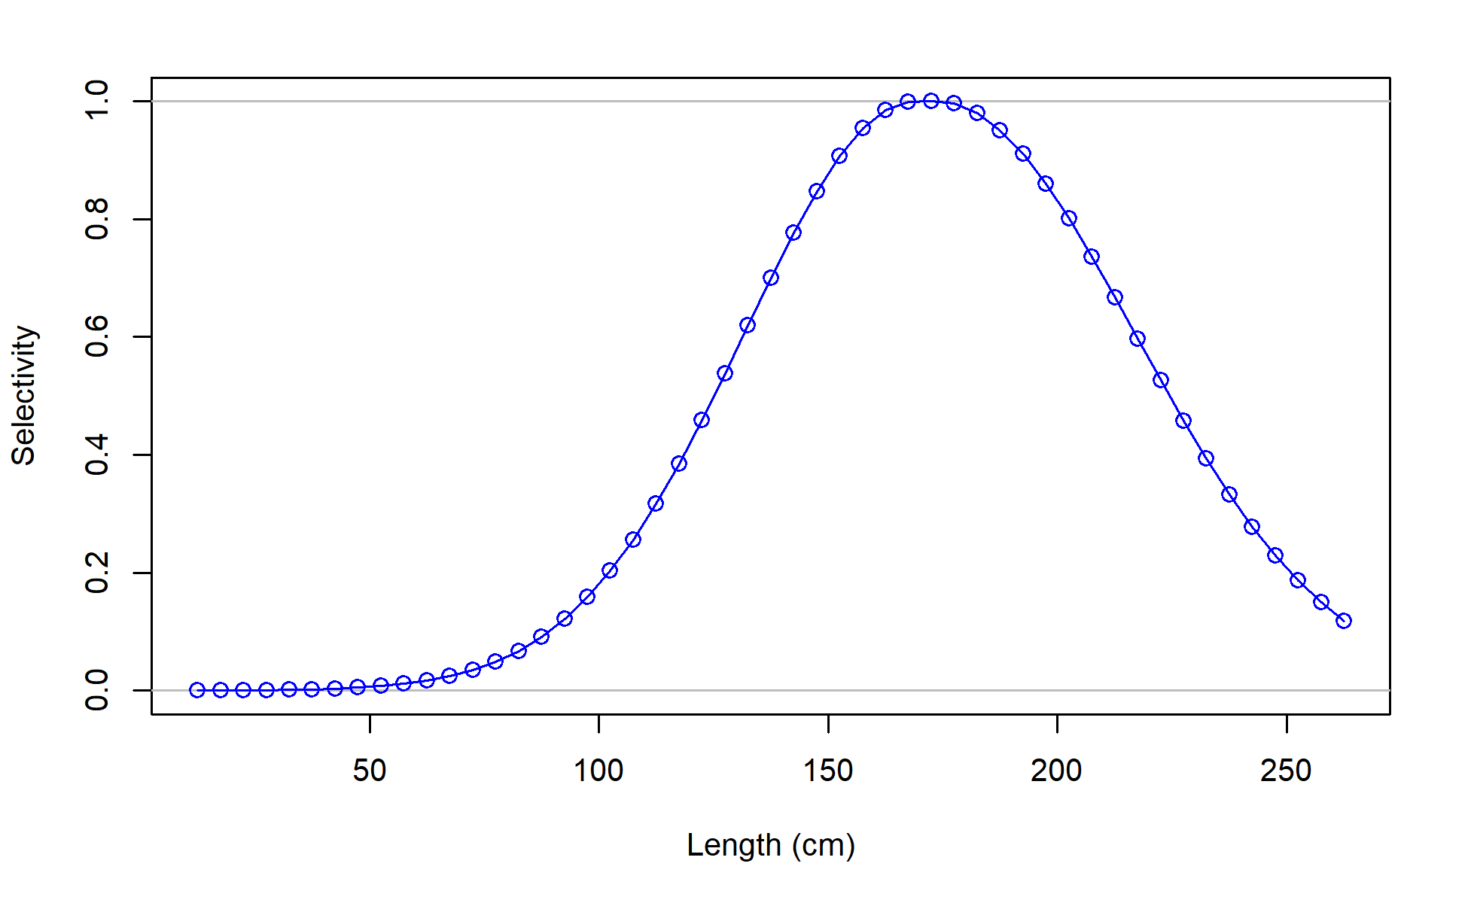
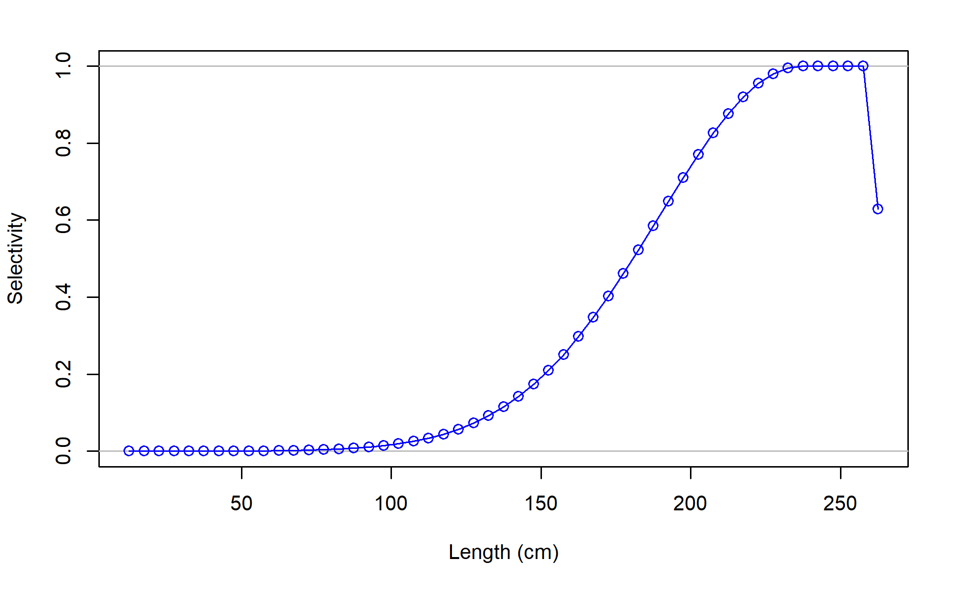
Selectivity
F01_JPN_WCNPO_OSDWLL_late_area1
F04_IATTC
F02_TWN_WCNPO_DWLL_late
F06_JPN_WCNPO_OSDWLL_early_area1
F08_US_WCNPO_LL_shallow_early
F03_US_WCNPO_LL_shallow_late
F07_JPN_WCNPO_CODF

Slide 15
Model Diagnostics

Slide 16
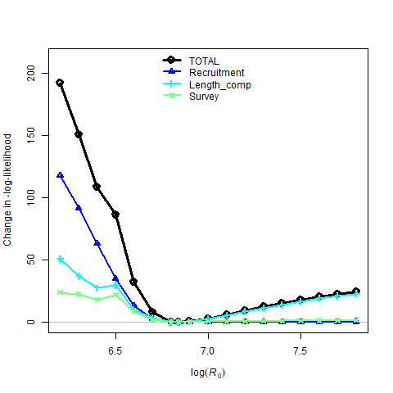
Results of Likelihood Profiles by Data Component for Unfished Recruitment R₀

Slide 17
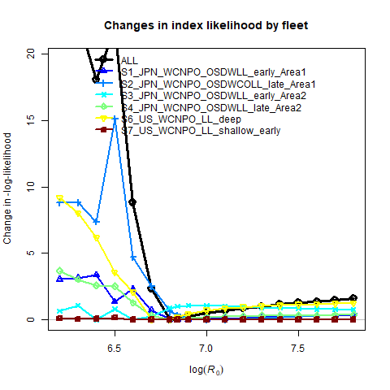
Results of Likelihood Profiles by Data Component for Unfished Recruitment R₀

Slide 18
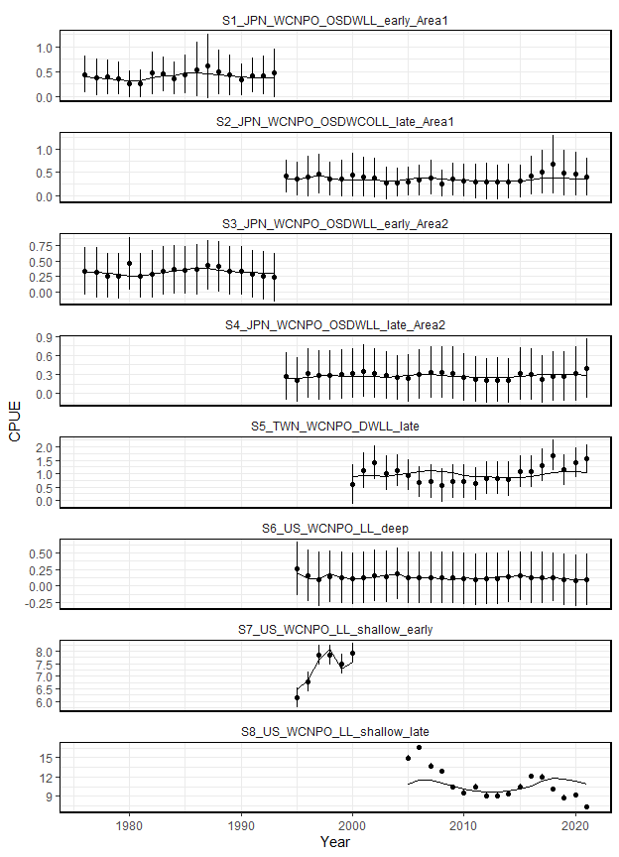
CPUE Diagnostics
S5 and S8 were not fit in the likelihood
S6 is fit as an index of recruitment

Slide 19
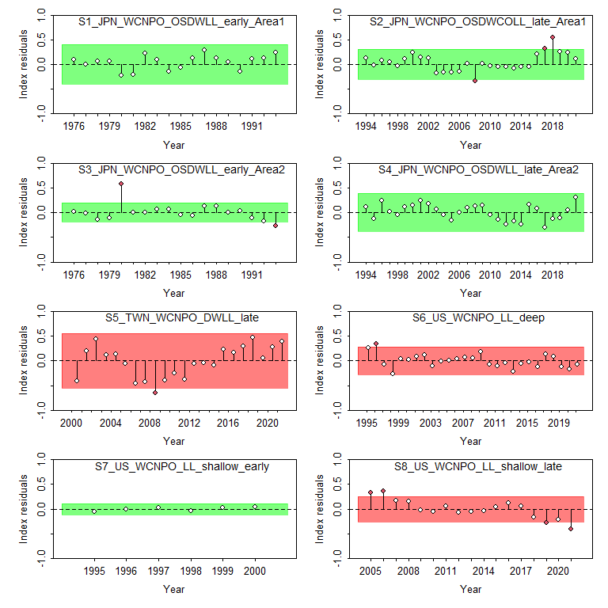
CPUE Runs Test

Slide 20
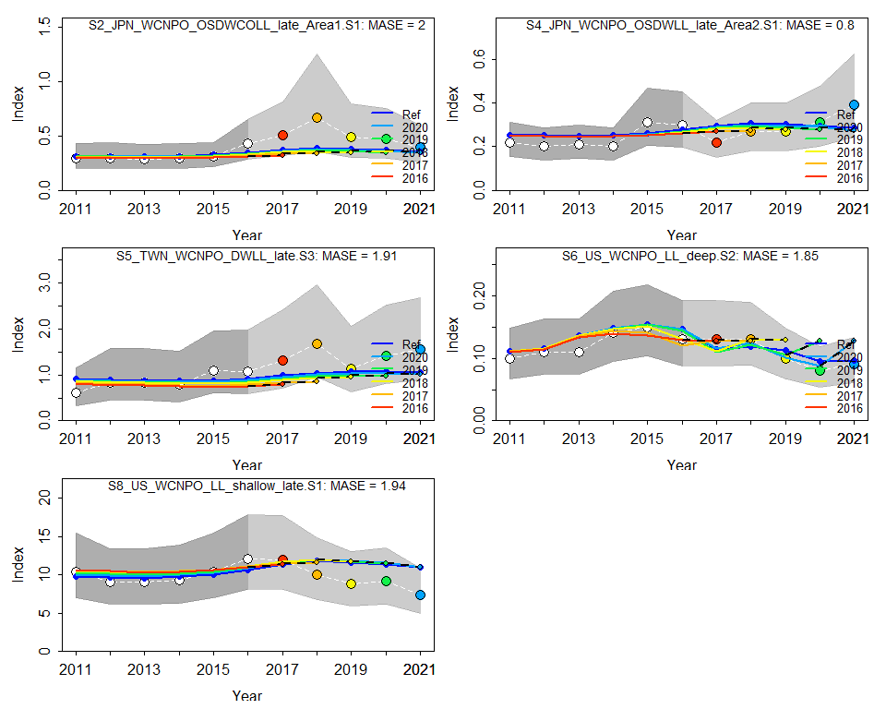
CPUE Hindcast cross-validation

Slide 21
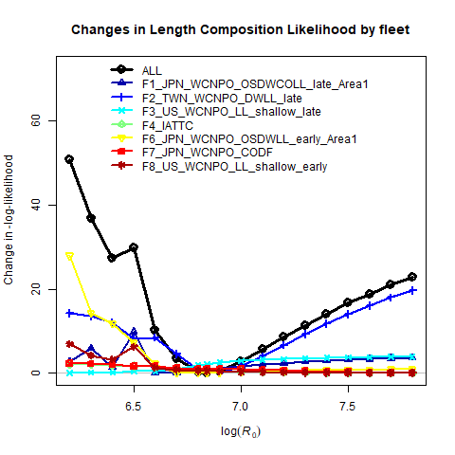
Results of Likelihood Profiles by Data Component for Unfished Recruitment R₀

Slide 22
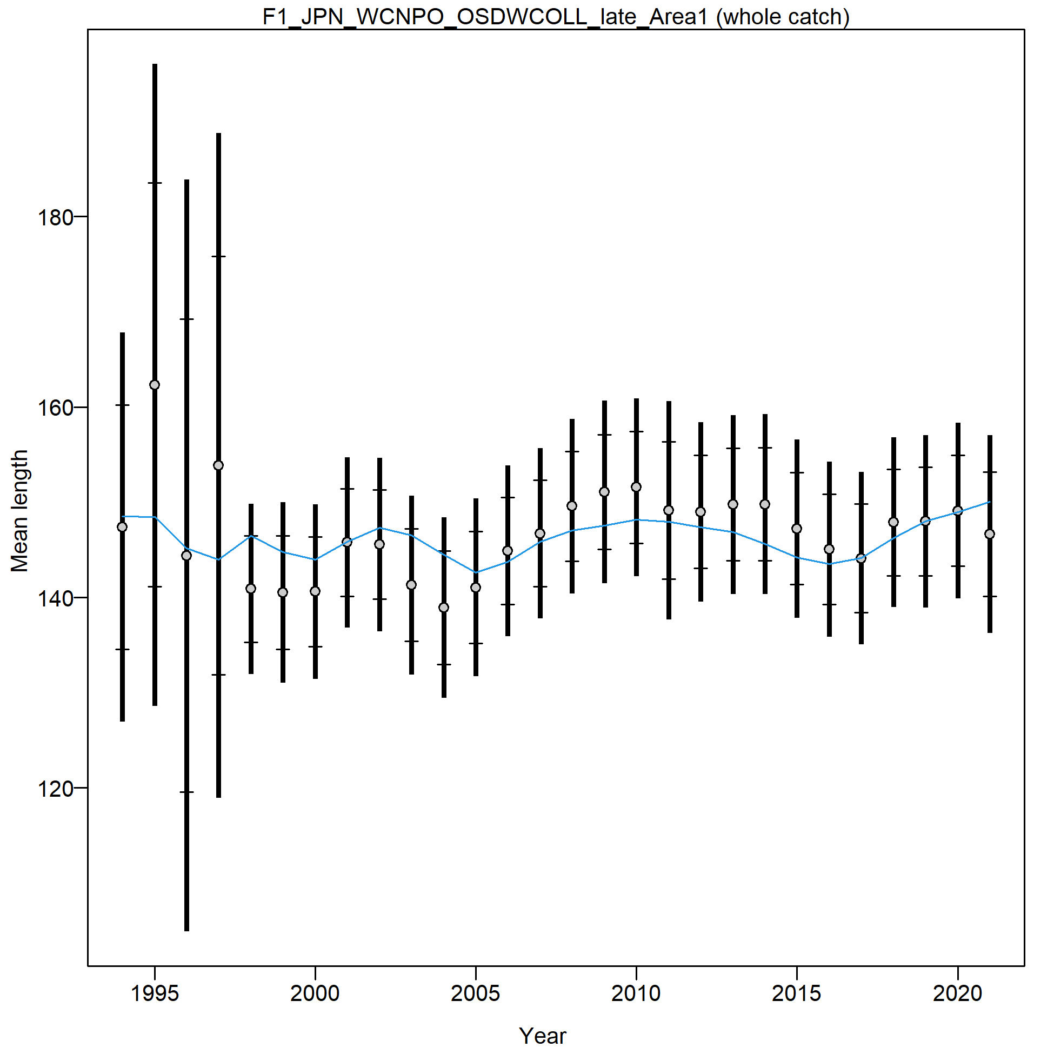
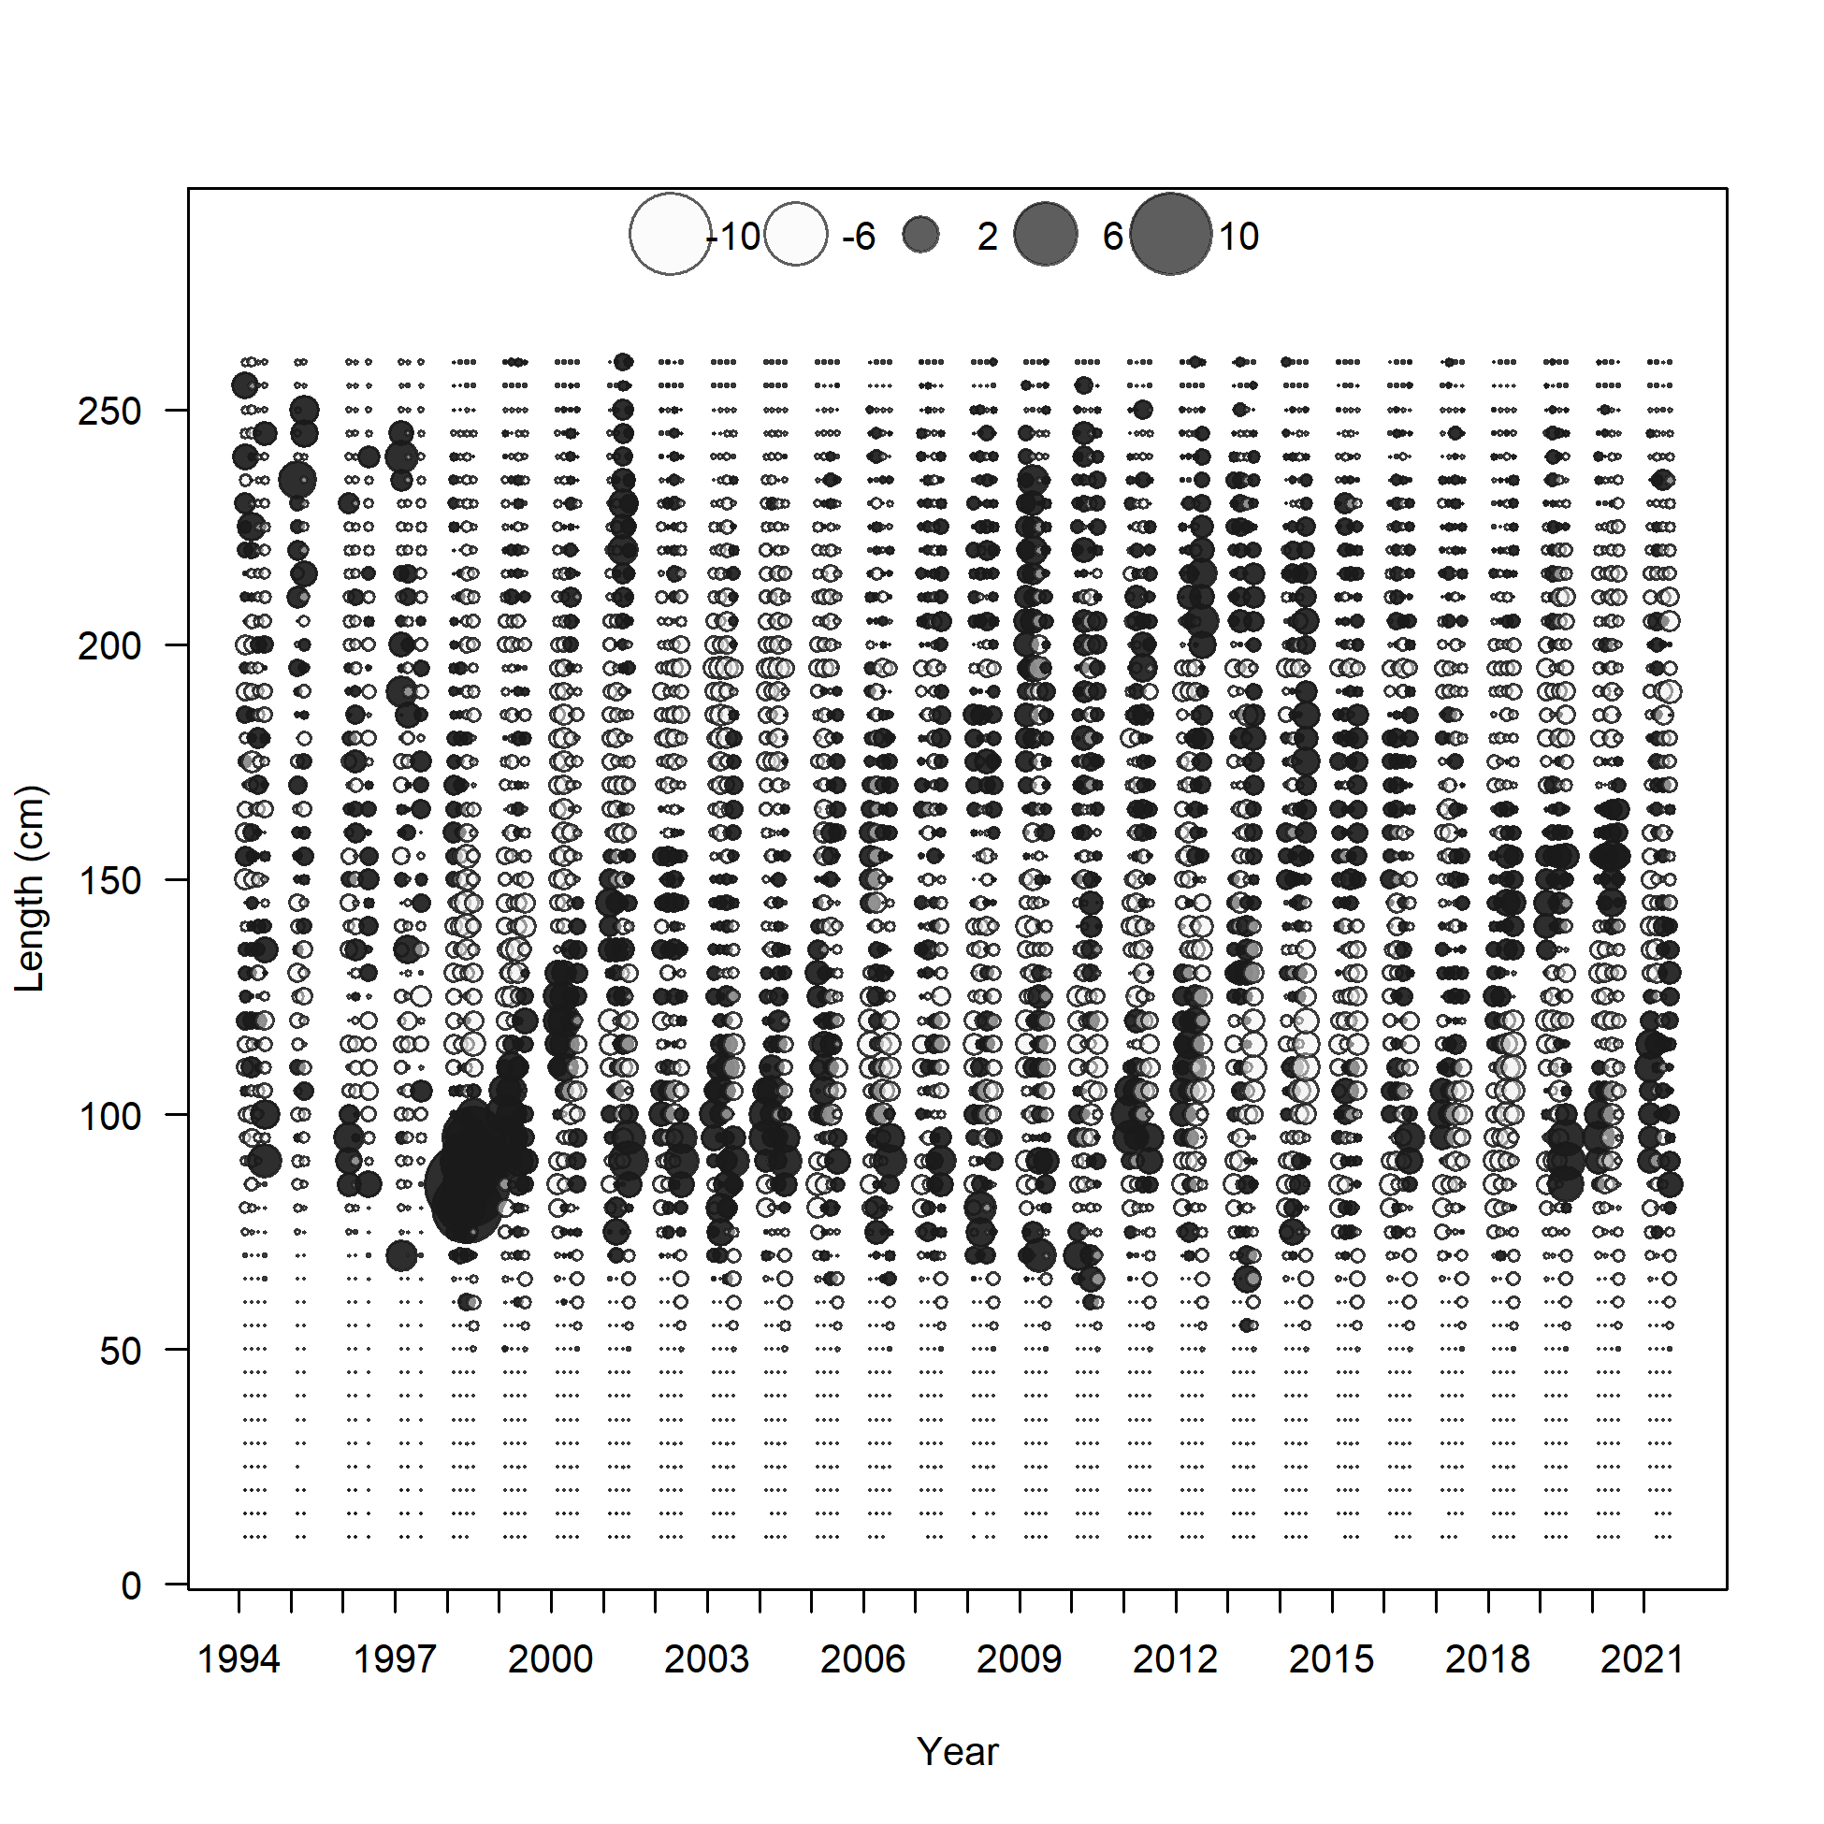
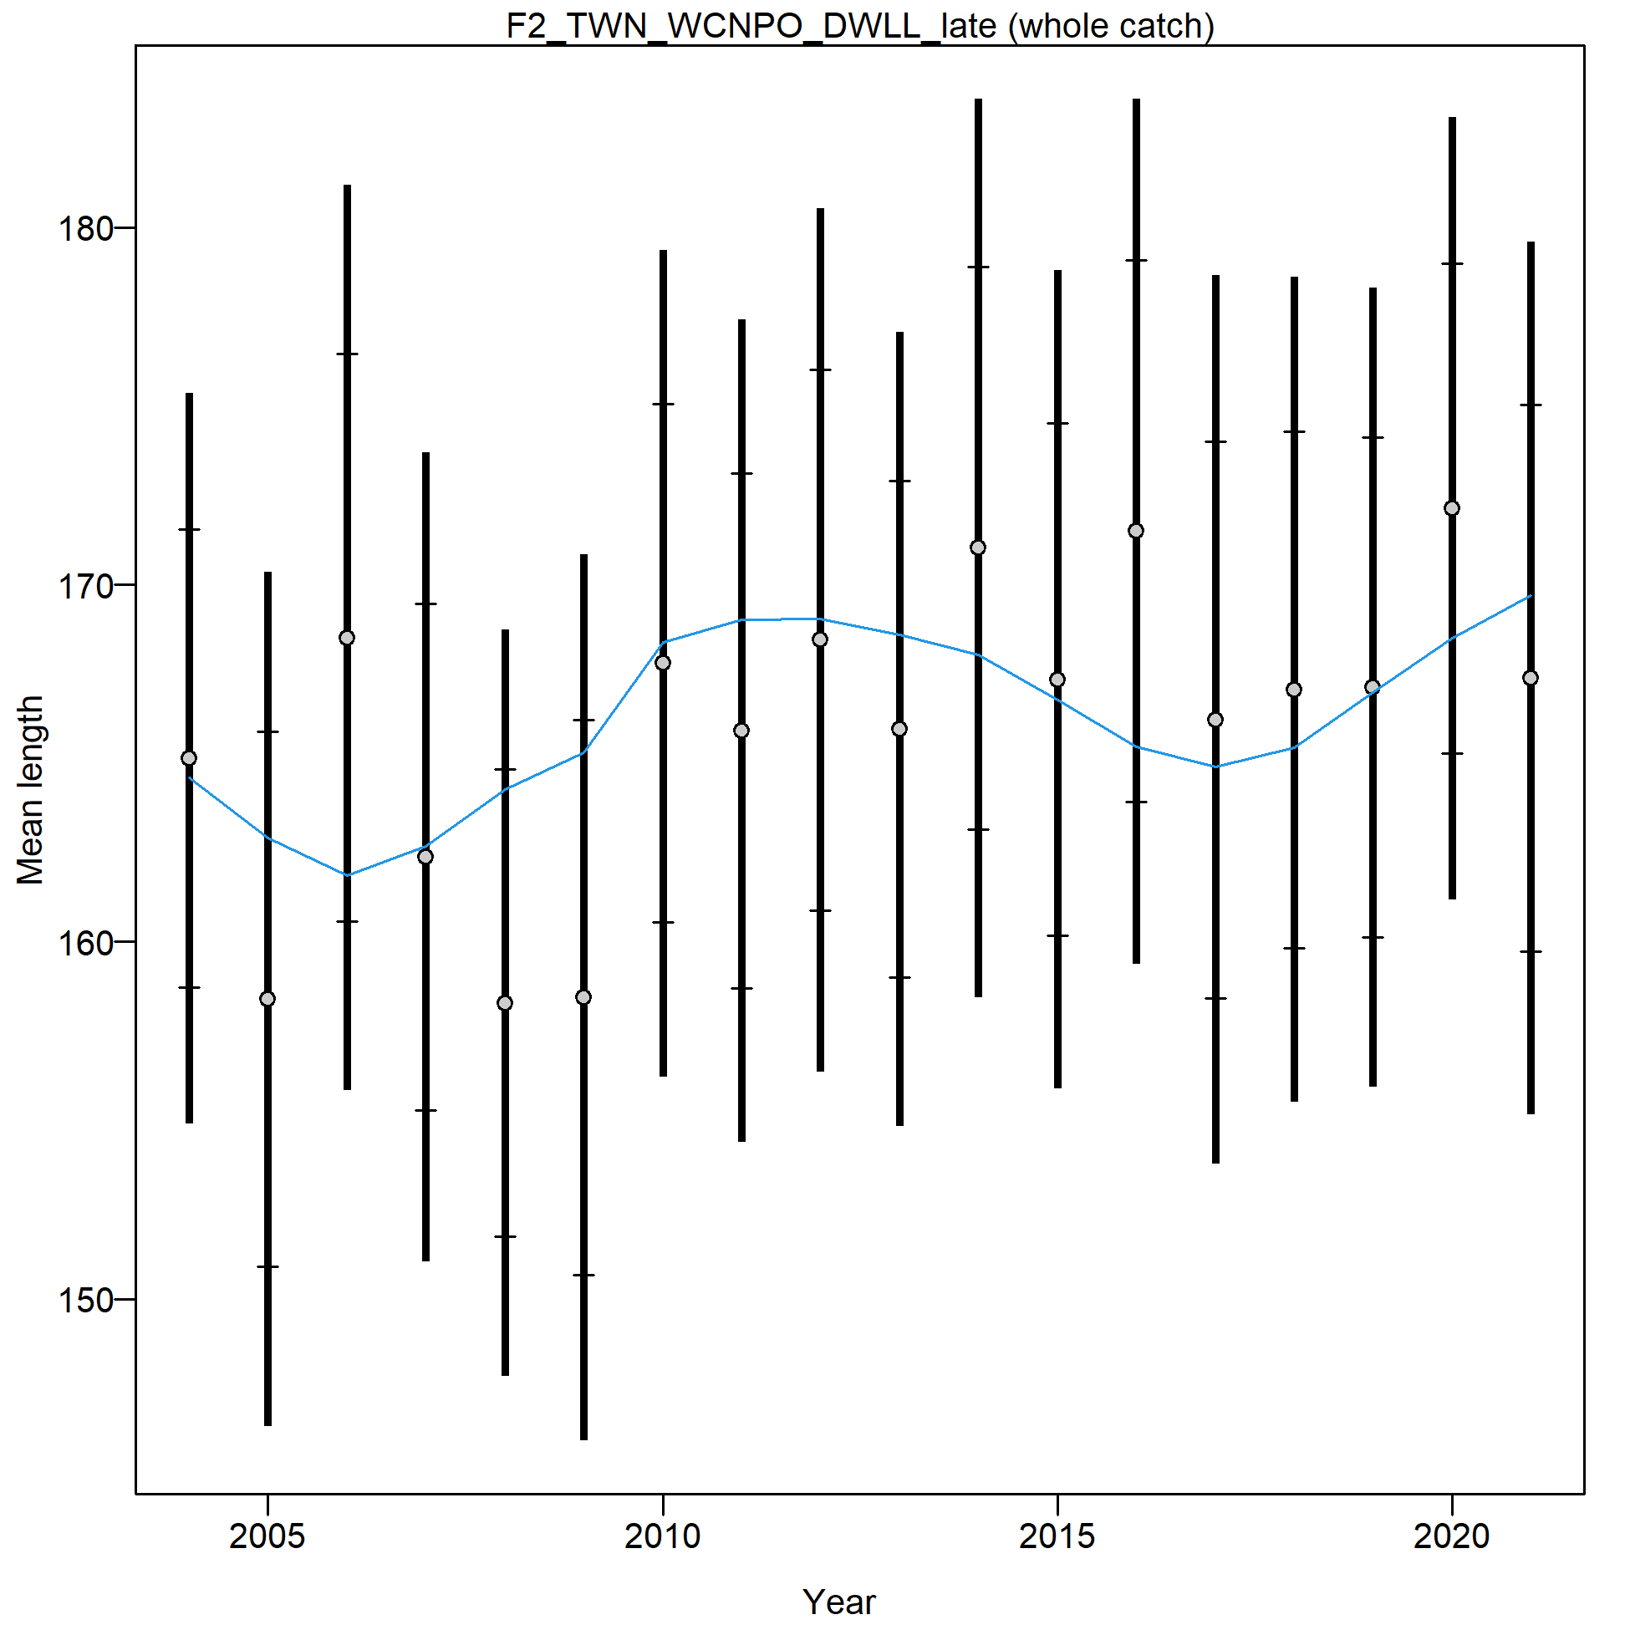
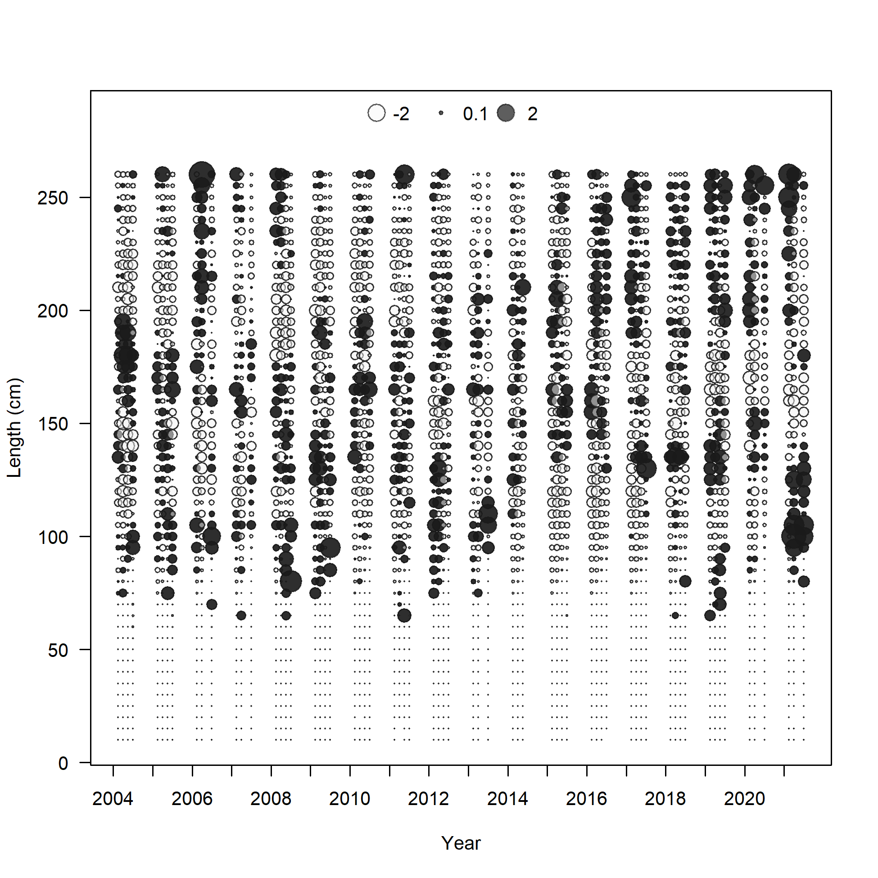
Fit to the Size Composition Data

Slide 23
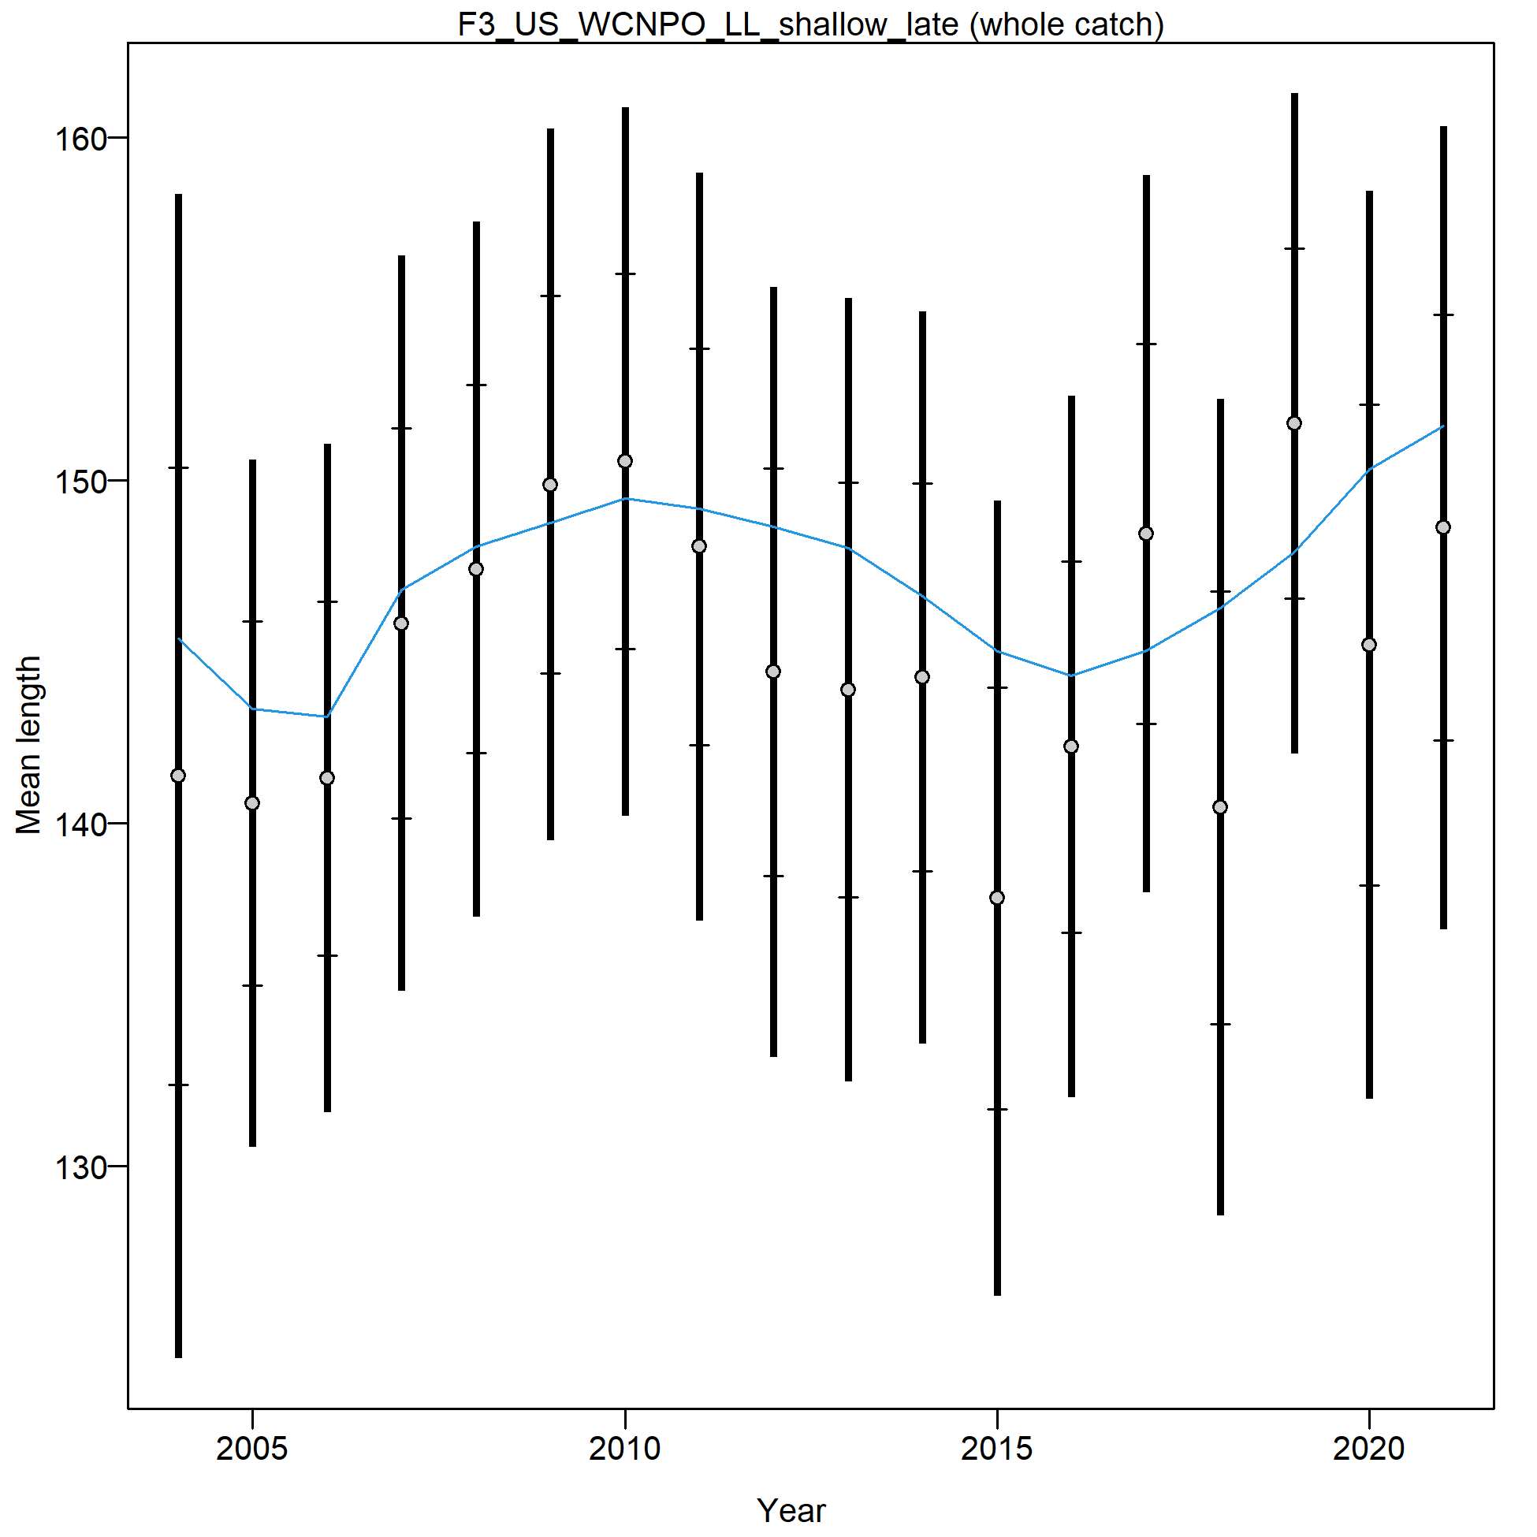
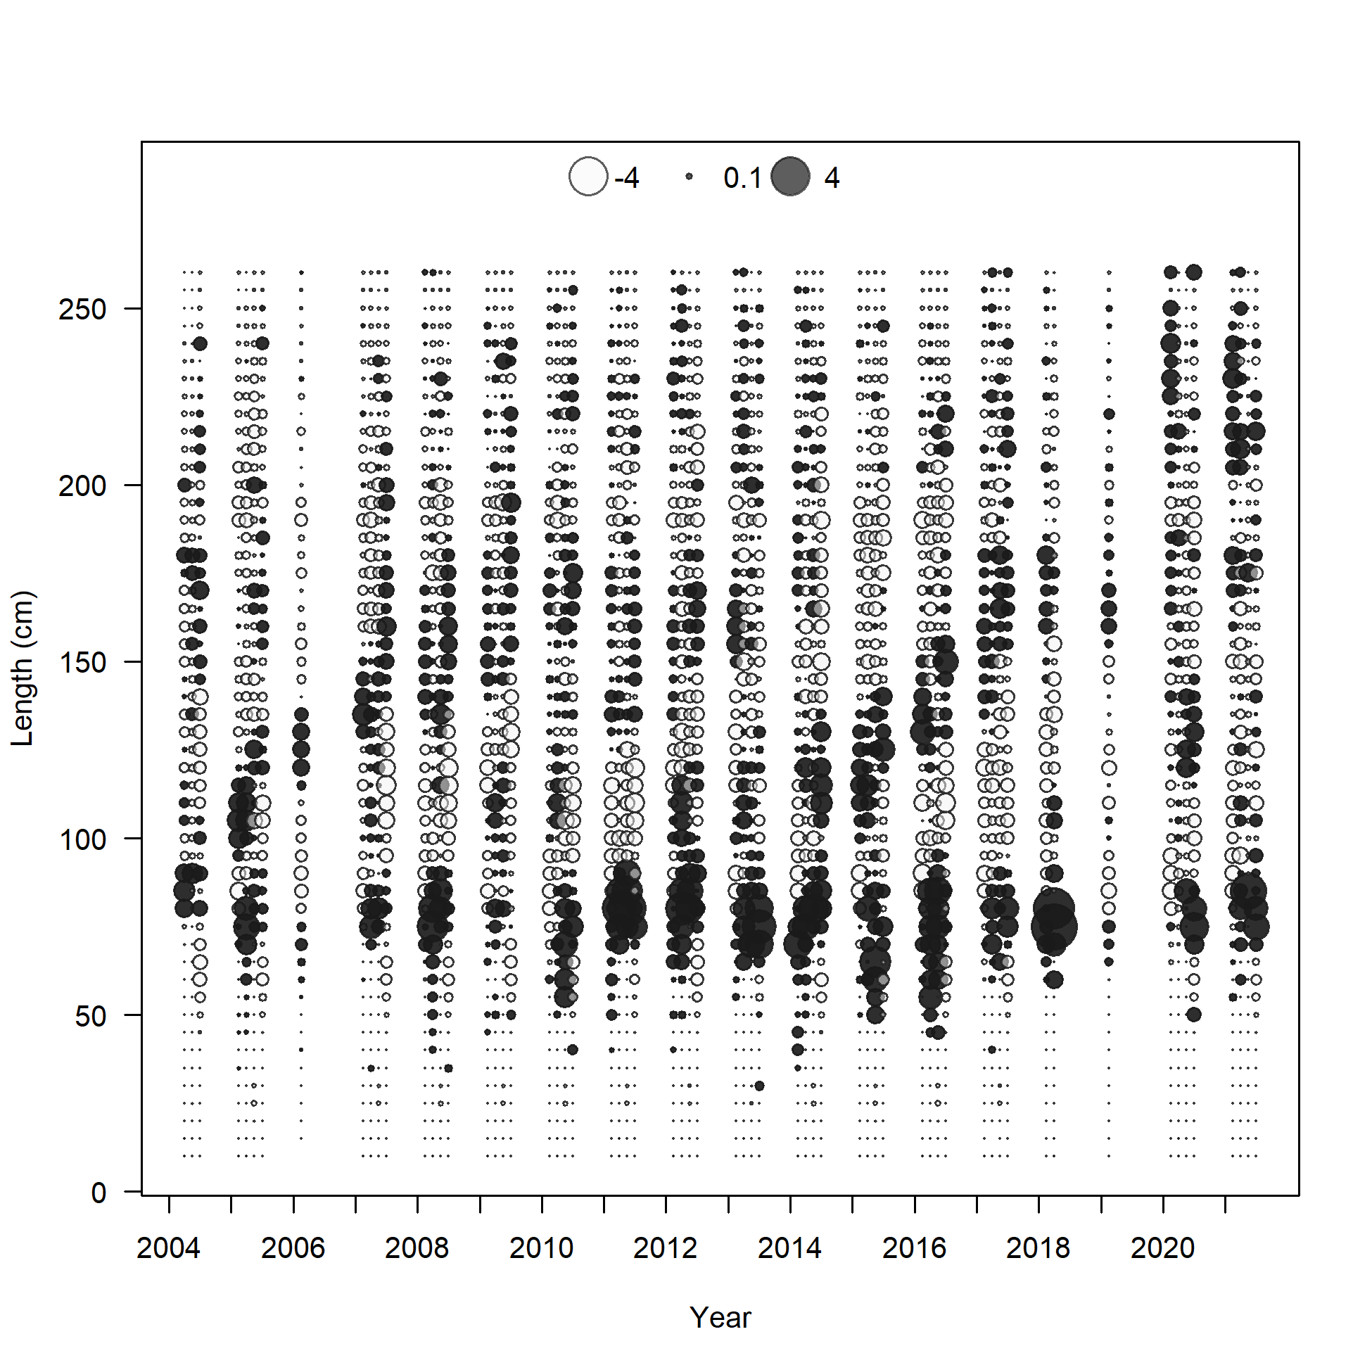
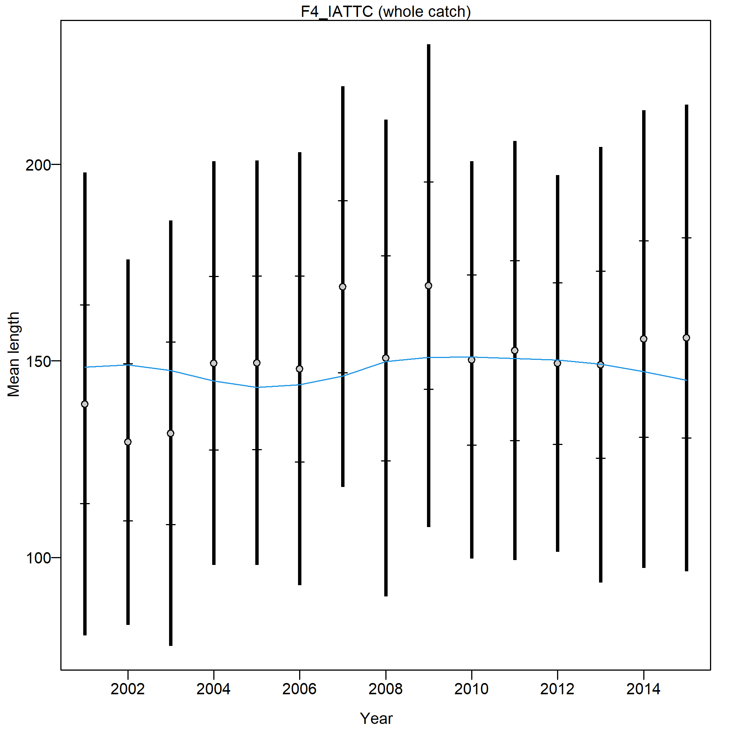
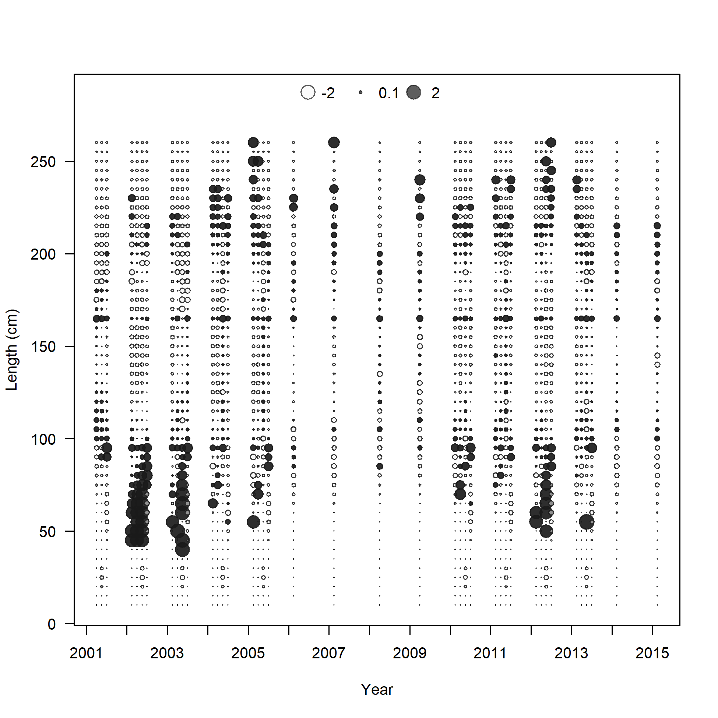
Fit to the Size Composition Data

Slide 24
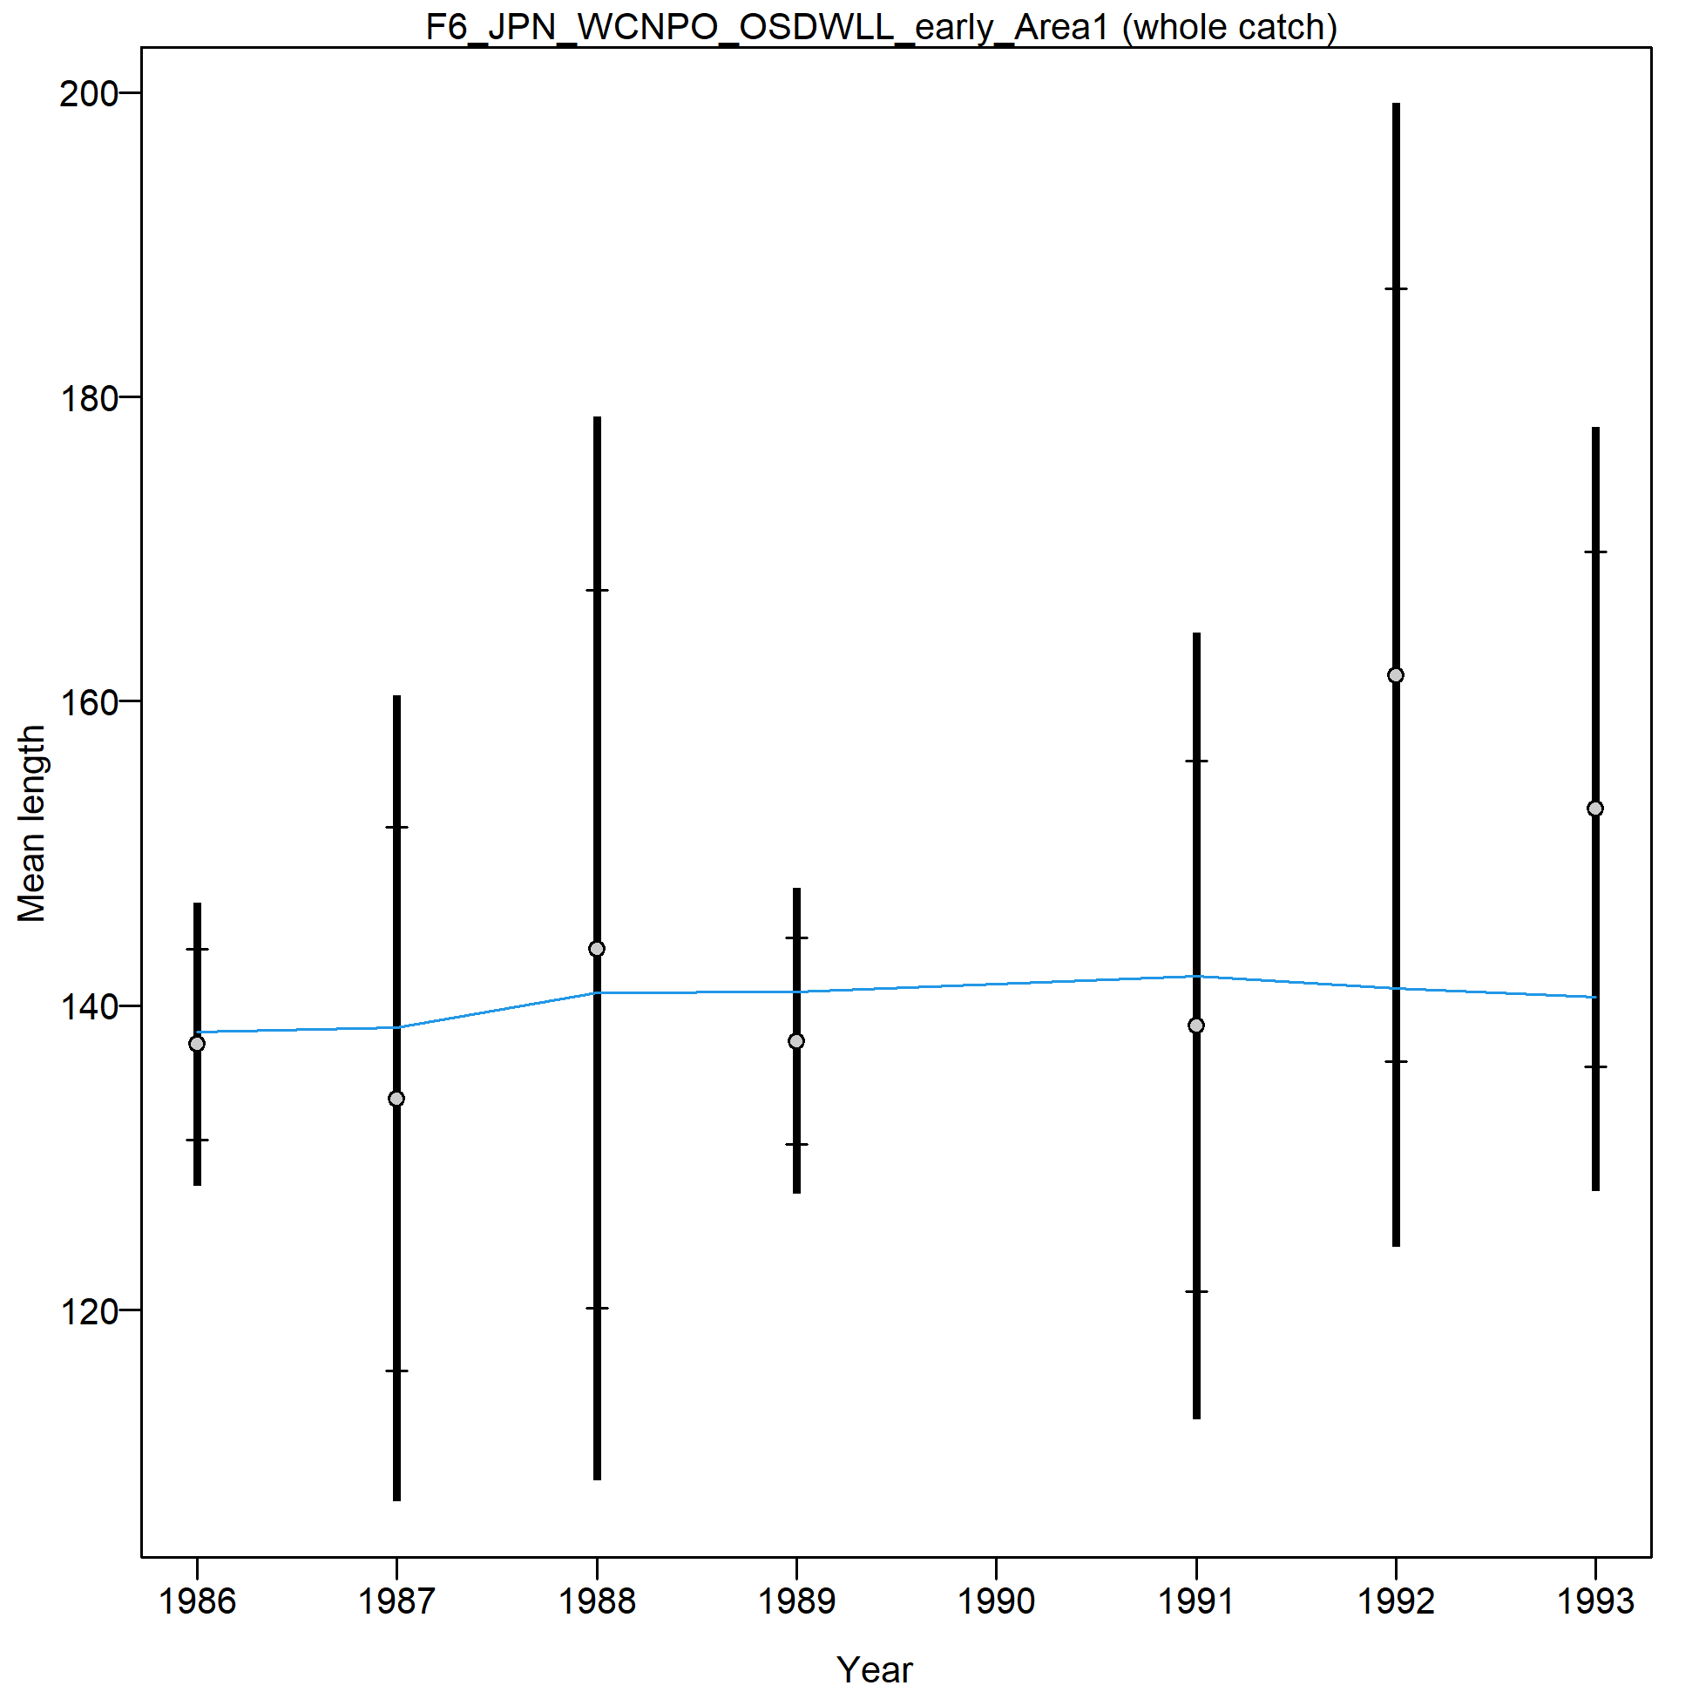
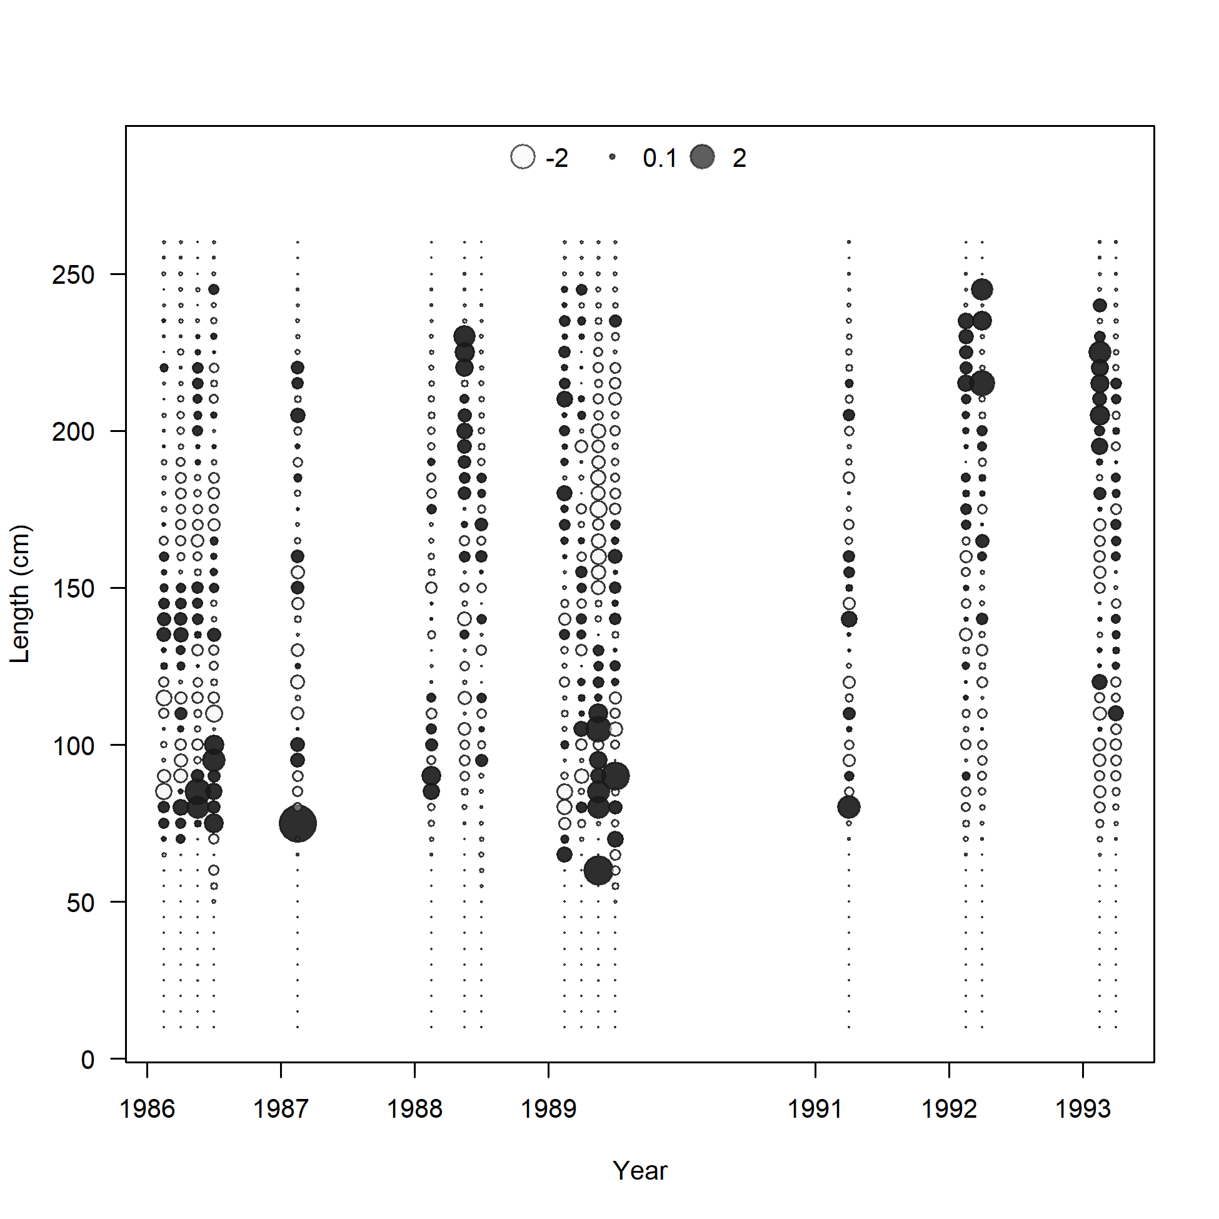
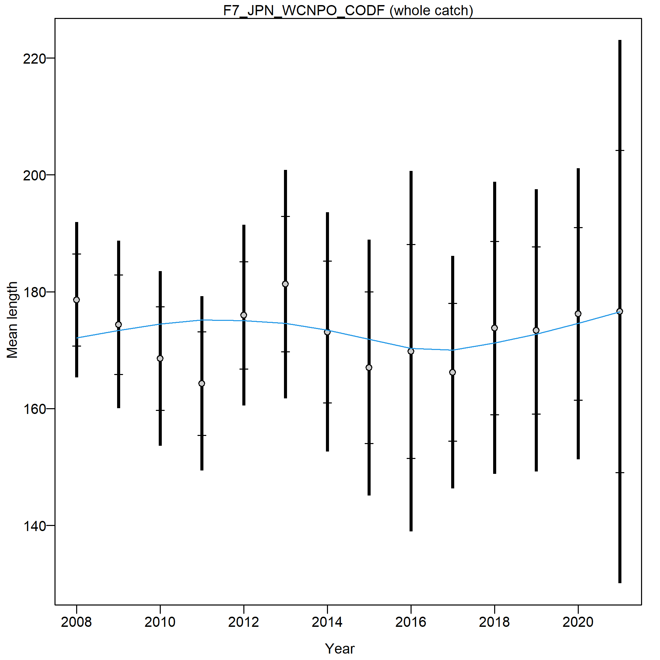
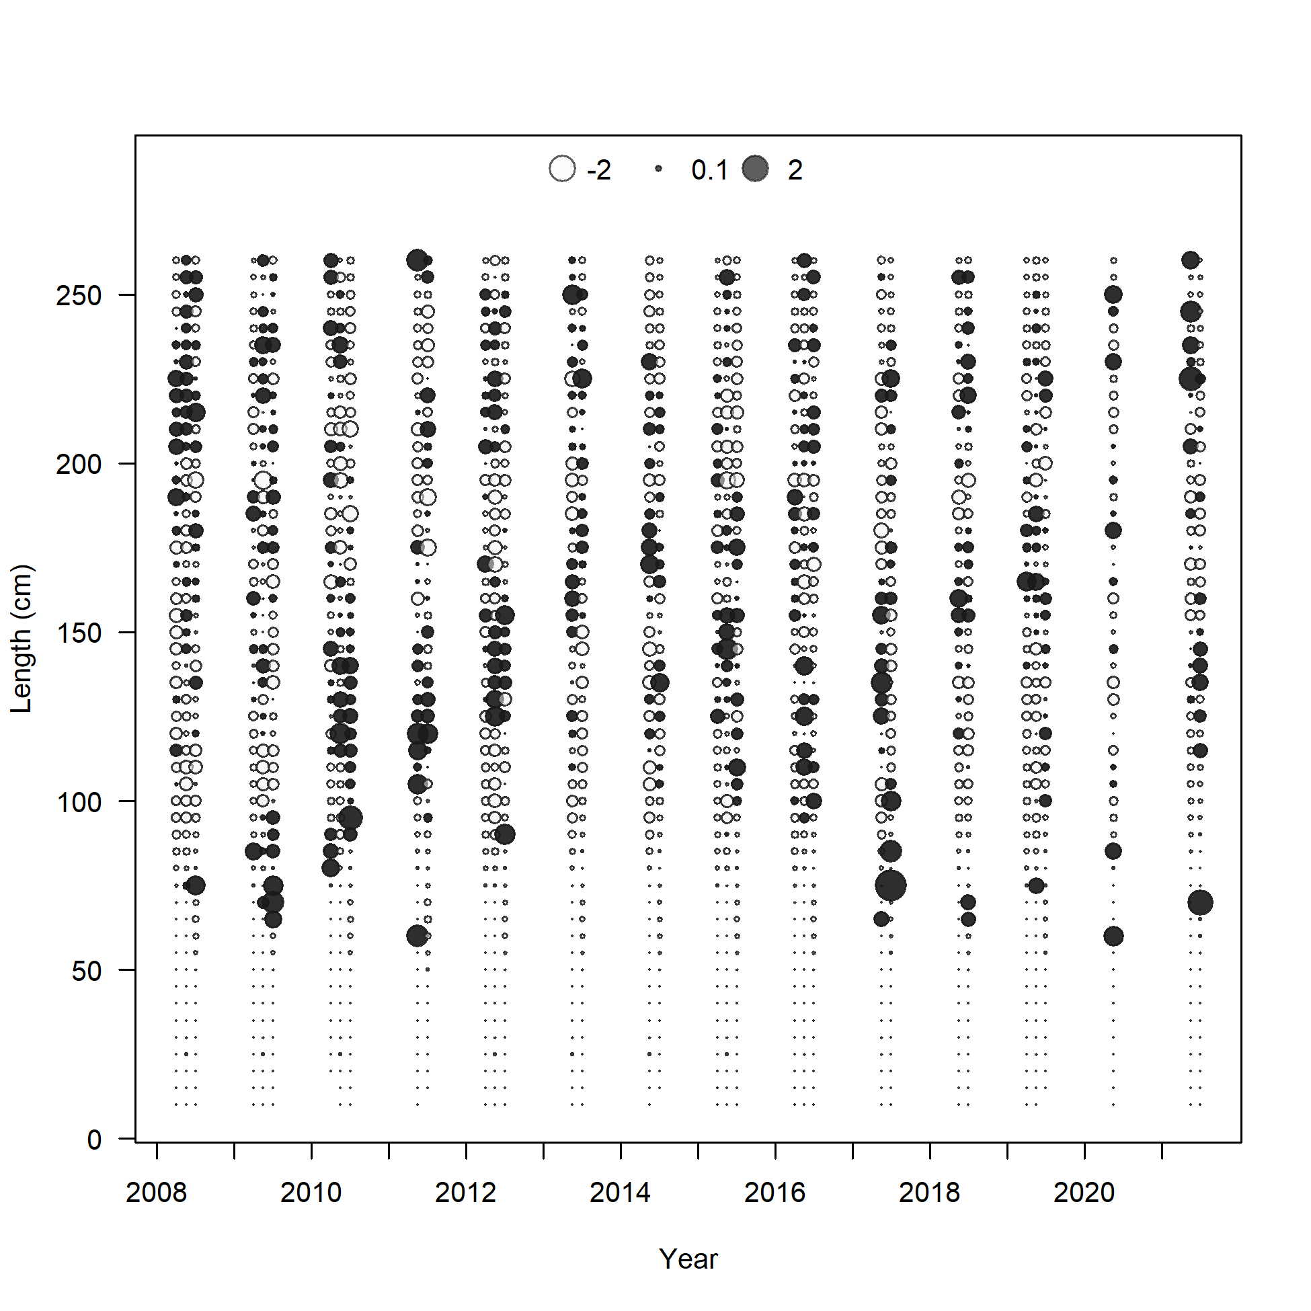
Fit to the Size Composition Data

Slide 25
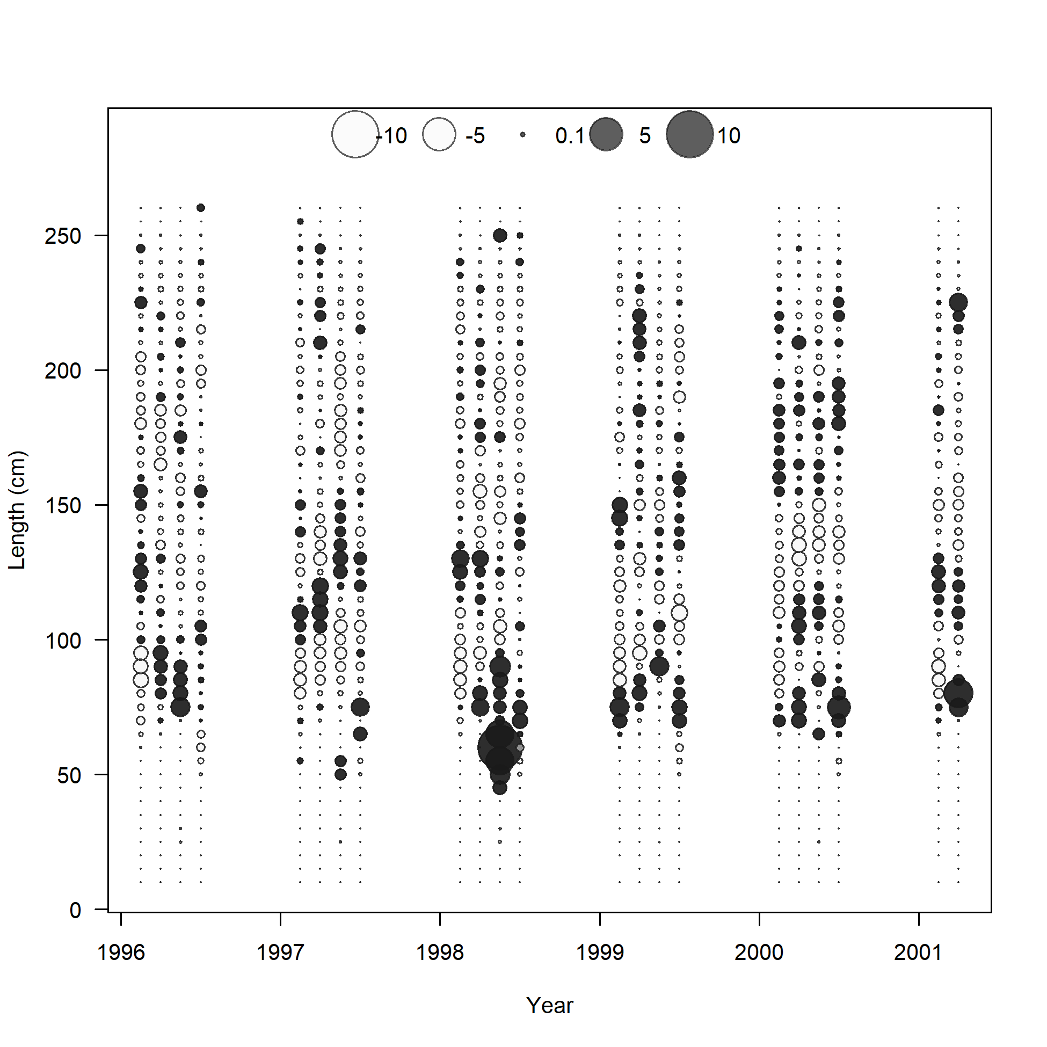
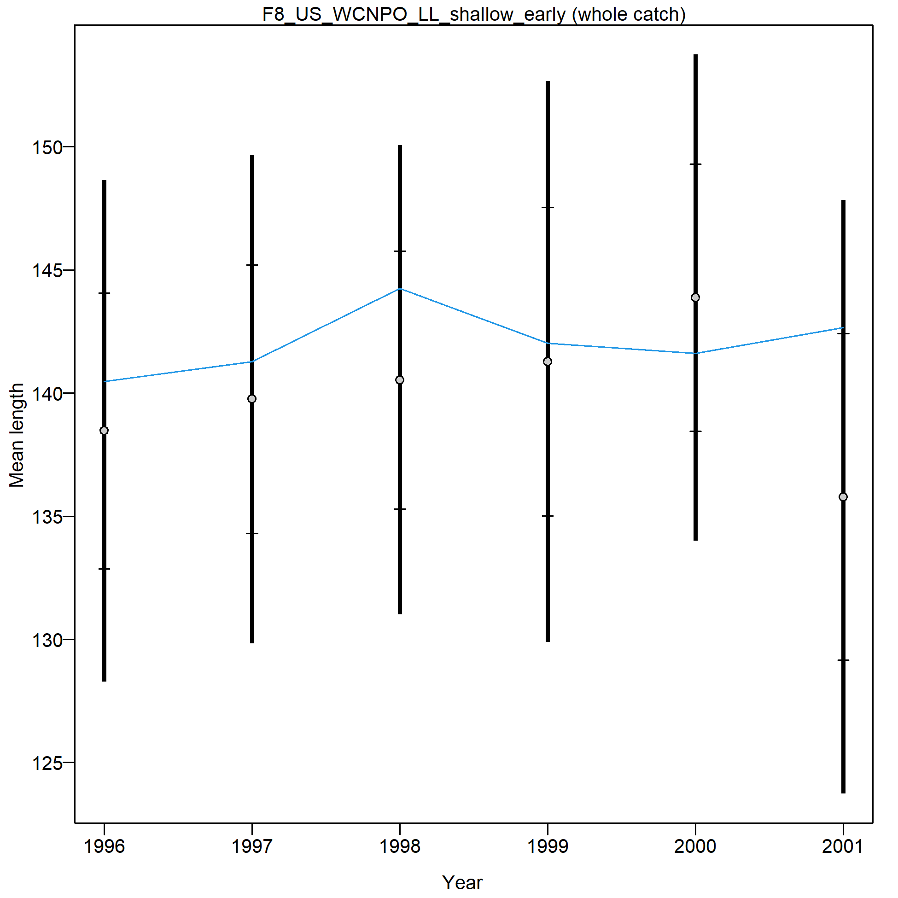
Fit to the Size Composition Data

Slide 26
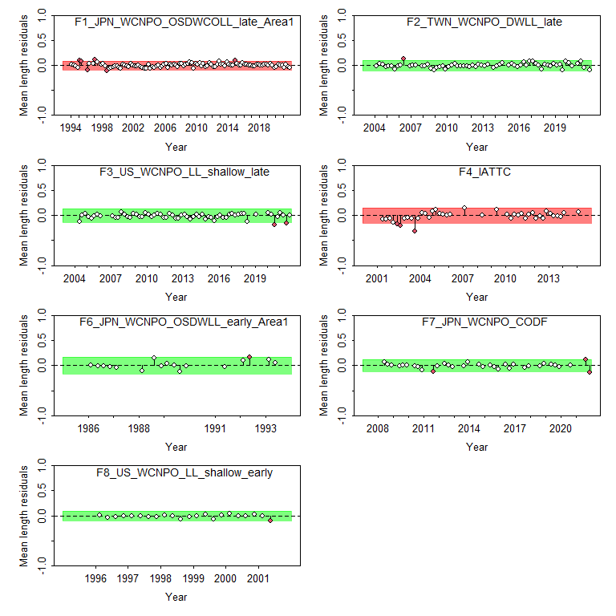
Length Runs Test

Slide 27
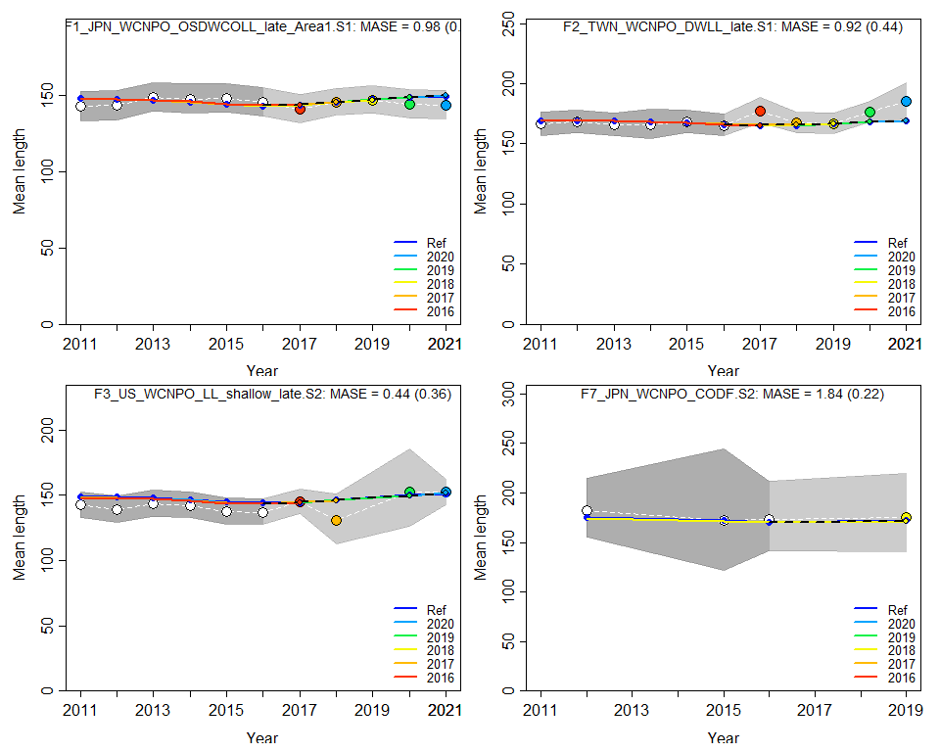
Length Hindcast cross-validation

Slide 28
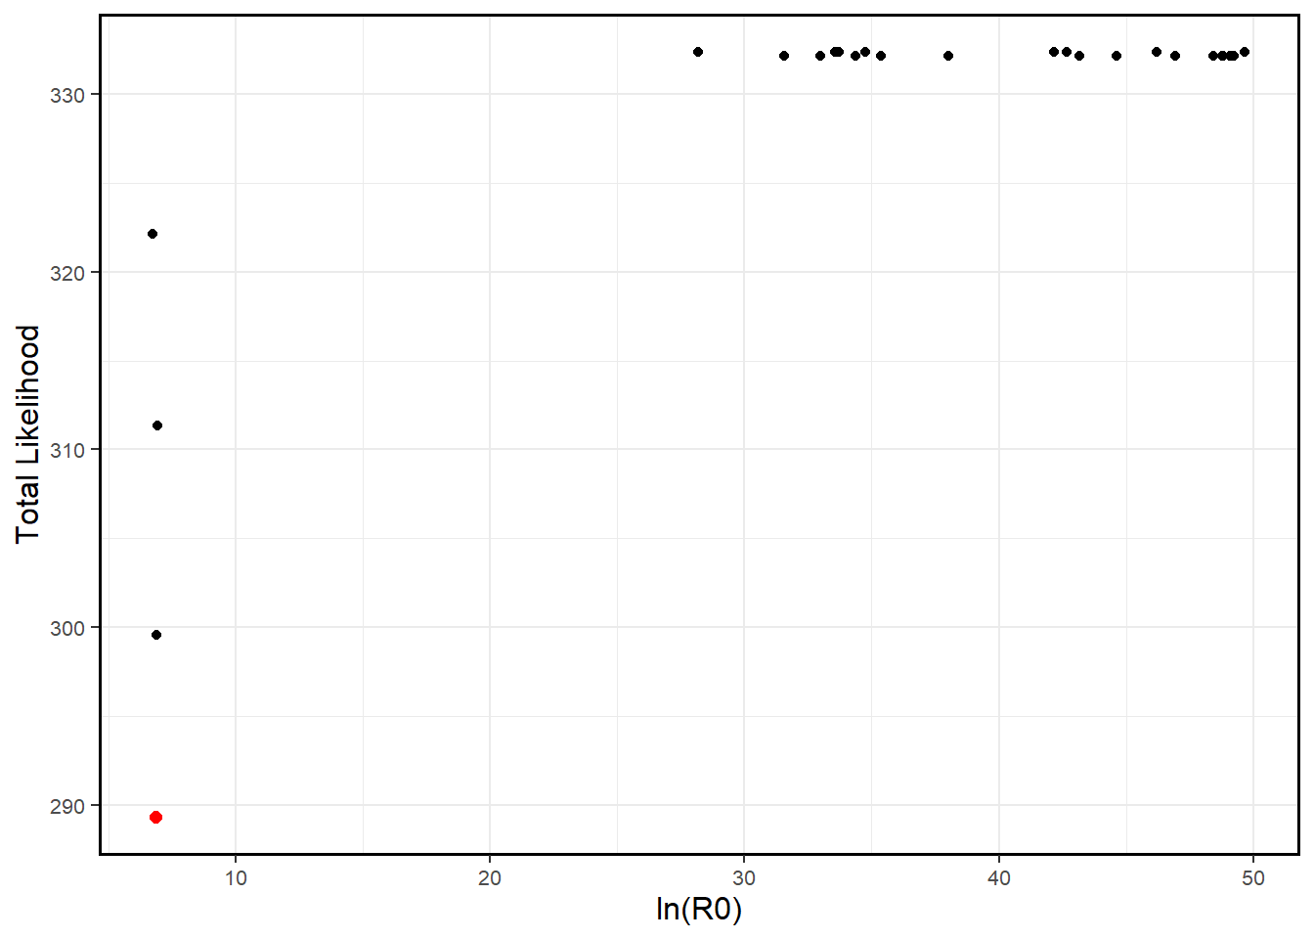
Jitter Plot

Slide 29
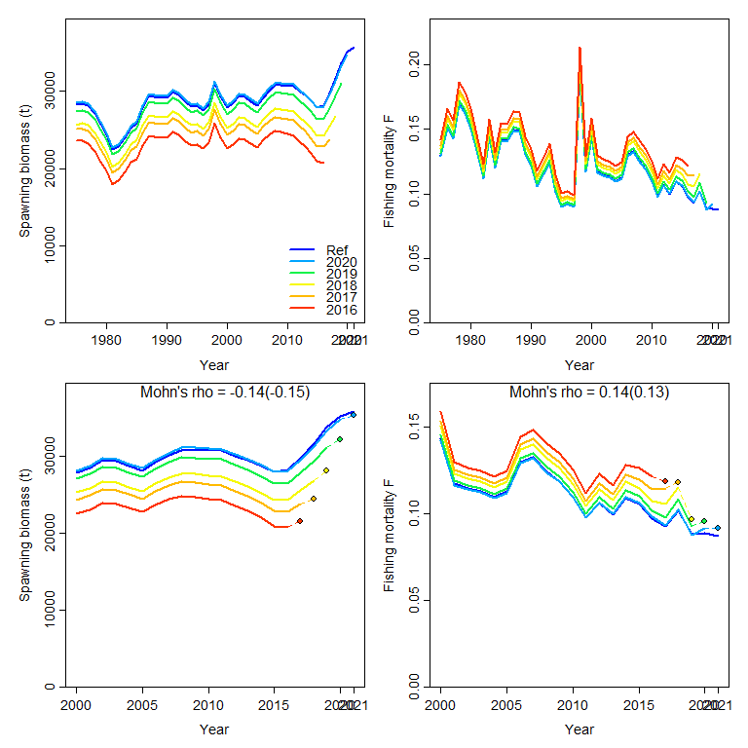
Retrospective Analysis

Slide 30
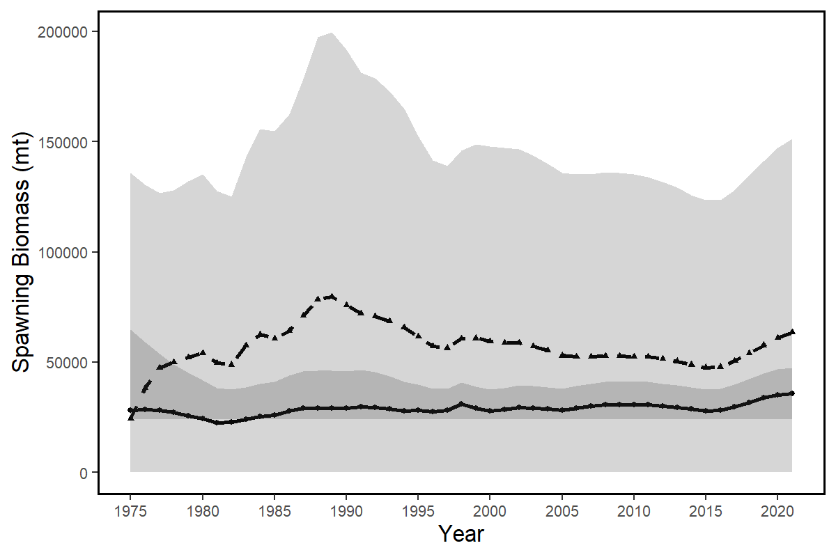
Age Structured Production Model

Slide 31
NP Swordfish Benchmark Stock Assessment
Stock Status and Conservation Information

Slide 32
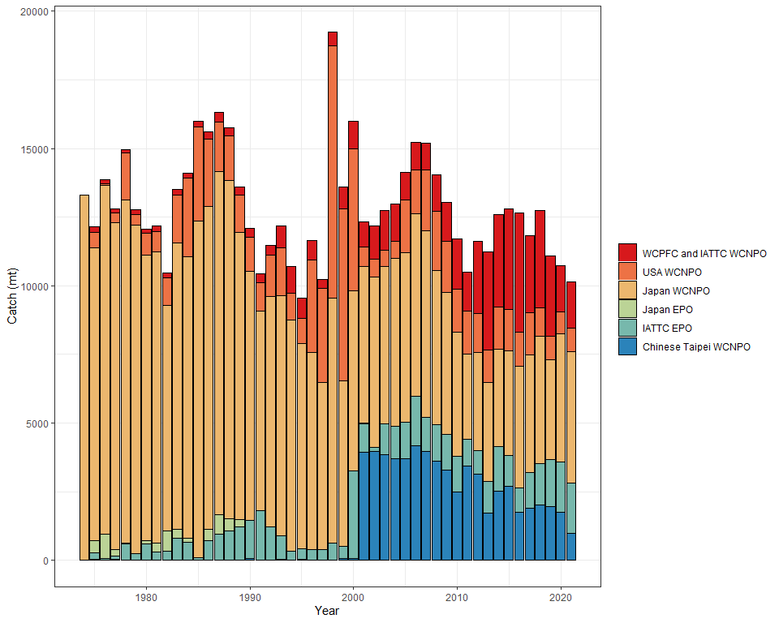
WCNPO Swordfish Catch by ISC Country

Slide 33
NP Swordfish Reference Points
WCPFC16 established a limit reference point for the exploitation rate of North Pacific Swordfish of F_{MSY}
SSB_{F=0} was set to equal the average of the last 5 years dynamic B0 if fishing ceased after that year.
NP swordfish reference points will be provided with reference to MSY and with reference to 20%SSB_{F=0}

Slide 34
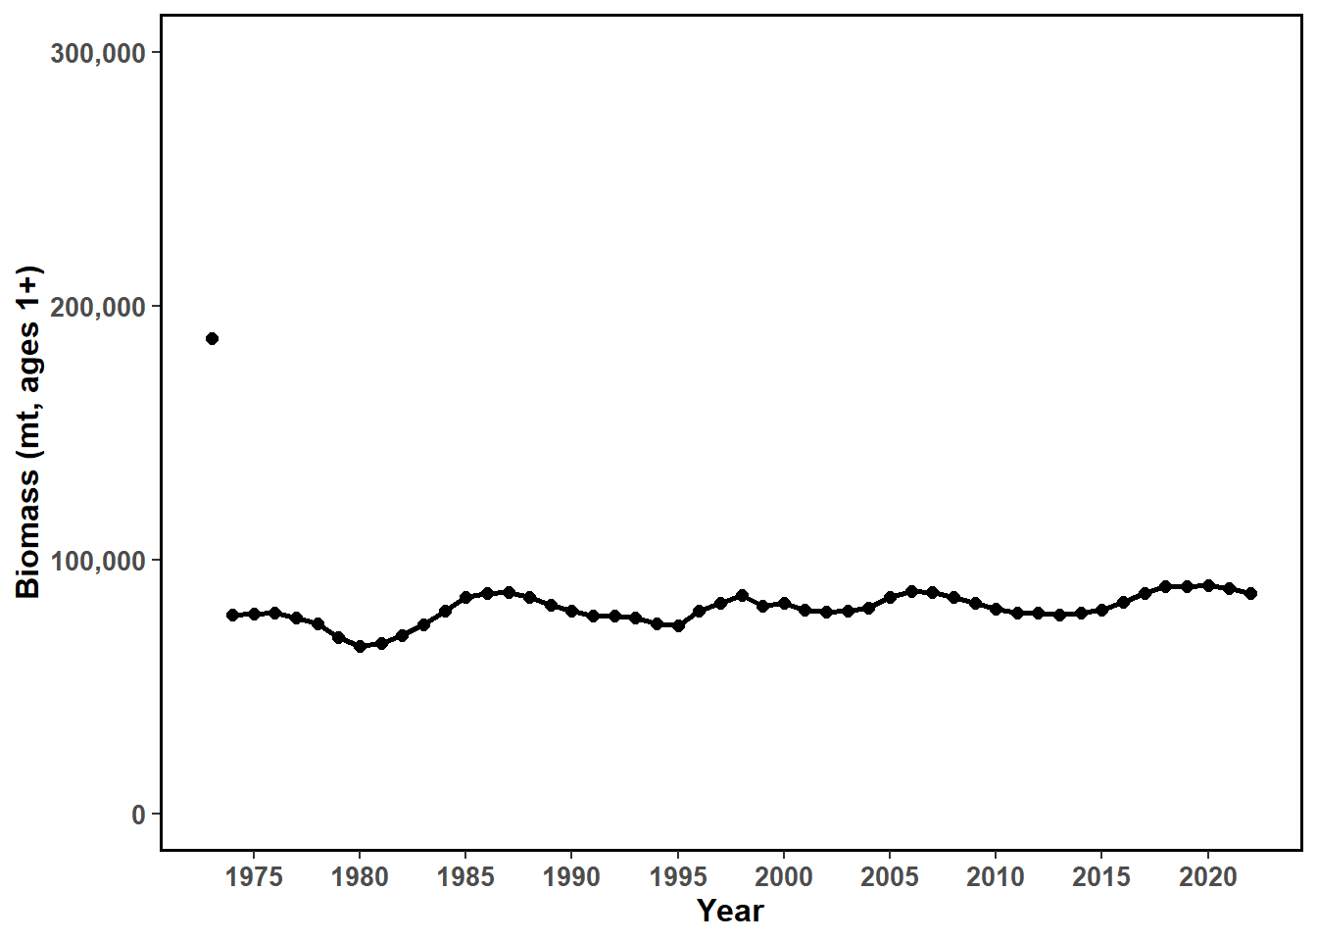
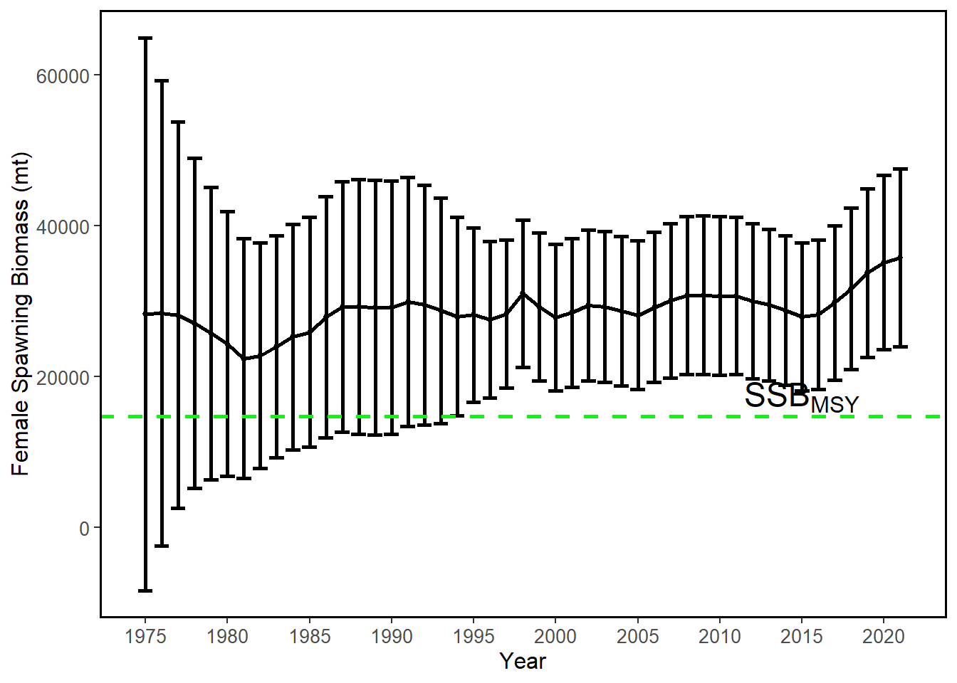
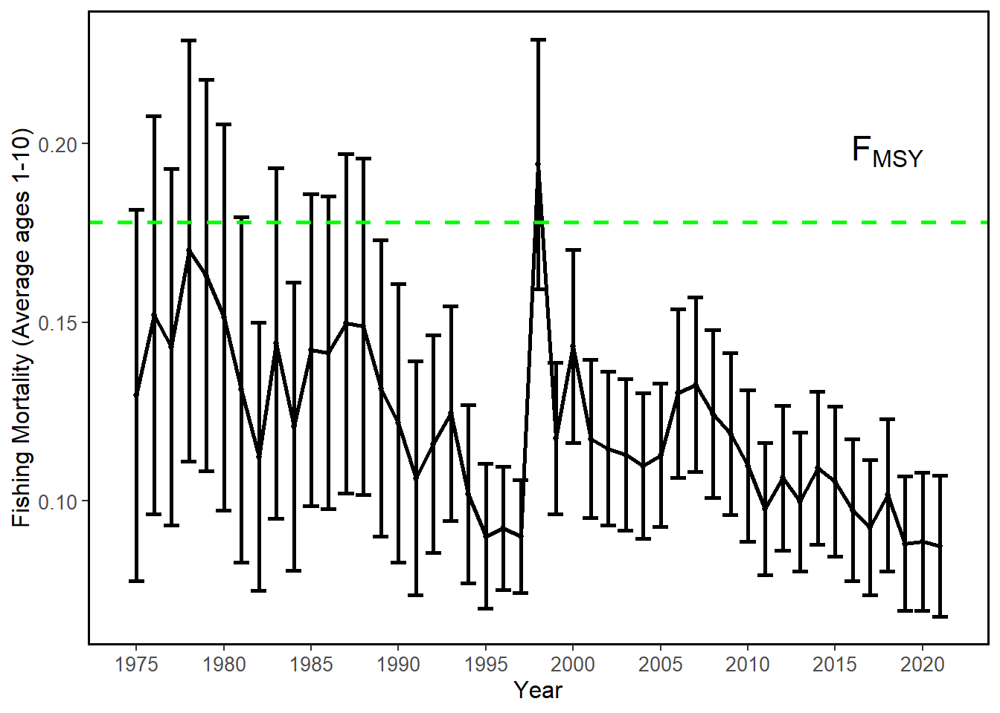
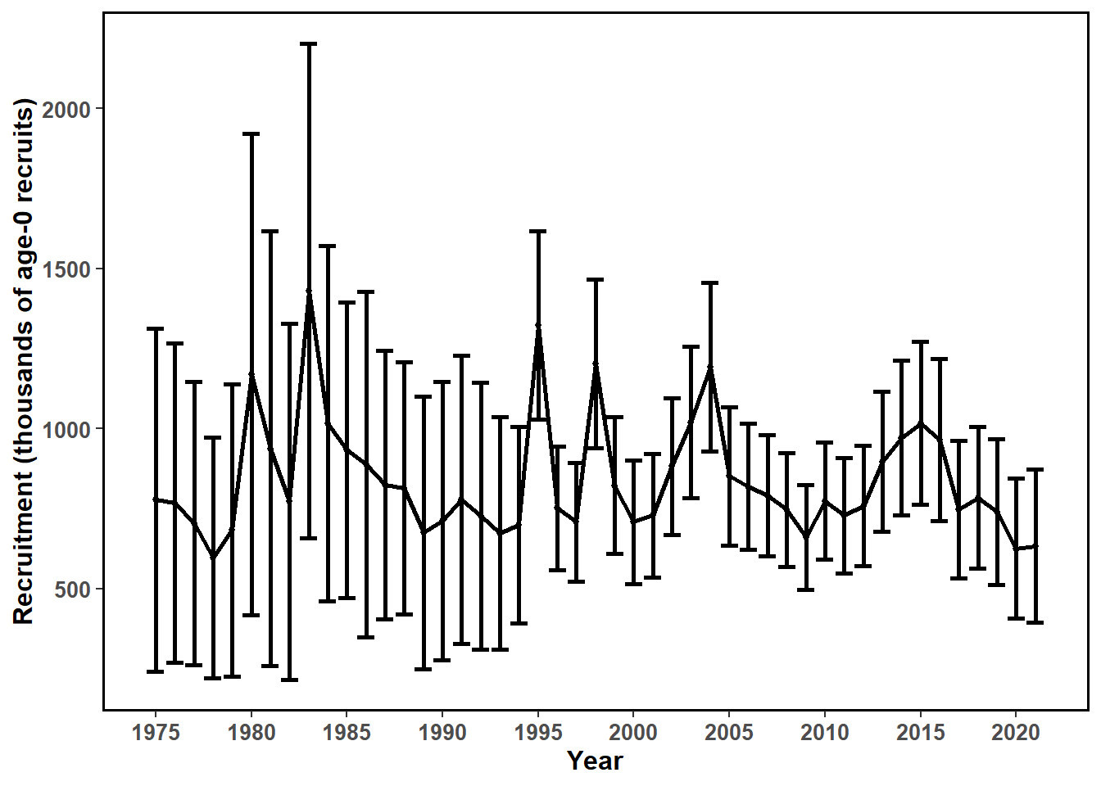

Slide 35
NP Swordfish Spawning Biomass
Estimates of female spawning stock biomass have been flat to increasing since 1975, with a slight increase in the last five years.
Current SSB is above 20%SSB_{F=0}- and MSY-based reference levels

Slide 36
Information on Stock Status
Female spawning stock biomass was estimated to be 35,778 mt in 2021, or about 220% of SSB_{MSY}, with a relative SSB/SSB_{MSY} = 2.18.
Estimated F (arithmetic average of F for ages 1 – 10) averaged roughly F=0.09 during 2019-2021 or about 49% below F_{MSY} with a relative fishing mortality of F/F_{MSY} = 0.49 in 2021.
Relative to MSY-based reference points, overfishing is very likely not occurring (>99% probability) and the NP SWO stock is very likely not overfished (>99% probability)

Slide 37
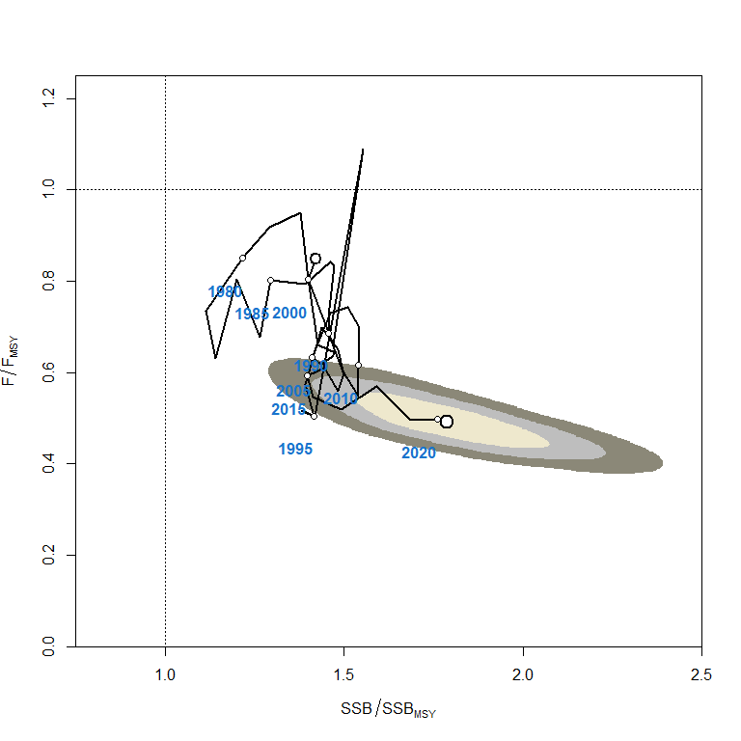
Reference Point | Estimate
F_{20%SSB(F=0)} (age 1-10)* | 0.16
F_{MSY} (age 1-10) | 0.18
F₂₀₂₁ | 0.09
F₂₀₁₉₋₂₀₂₁ | 0.09
SSB_{F=0}* | 95,732 mt
20%SSB_{F=0}* | 19,146 mt
SSB_{MSY} | 16,388 mt
SSB₂₀₂₁ | 35,778 mt
SSB₂₀₁₉₋₂₀₂₁ | 34,899 mt
C_{20%SSB(F=0)}* | 14,815 mt
C_{MSY} | 14,924 mt
C₂₀₁₉₋₂₀₂₁ | 10,653 mt
SPR_{20%SSB(F=0)}* | 22%
SPR_{MSY} | 19%
SPR₂₀₂₁ | 44%
SPR₂₀₁₉₋₂₀₂₁ | 43%
*20%SSB_{(F=0)} values based upon the average of the last 5 years dynamic B₀ (2017-2021)

Slide 38




Sensitivity Analyses on Life History Parameters
Model 1: High M
Model 2: Low M
Model 3: Steepness = 0.7
Model 4: Steepness = 0.81
Model 5: Steepness = 0.99

Slide 39




Sensitivity Analyses on Life History Parameters
Model 6: Large Amax
Model 7: Sun et al., 2007 Growth
Model 8: High Maturity L₅₀
Model 9: Low Maturity L₅₀
Model 10: Wang et al., 2003 maturity

Slide 40




Sensitivity Analyses on Model Decisions
Model 11: Drop all Vanuatu and Chinese Catch
Model 12: Use all NP SWO Catch
Model 13: Include Orphan Catch
Model 14: Change Amin to 1
Model 15: Don’t fit to S6
Model 16: TWN size comp selectivity to double normal
Model 17: Include F9 size data

Slide 41


Sensitivity Analyses on CPUE Decisions
Model 18a: S1 and S2
Model 18b: S3 and S4
Model 18c: S5 Only
Model 18d: S7 only
Model 18e: S8 only
Model 18f: S7 and S8
Model 19: All CPUE

Slide 42

Sensitivity Runs Kobe Plot

Slide 43
NP Swordfish Stock Projections
Five future harvest scenarios were analyzed:
F Low Scenario with F = F_{SPR30%}
F CMM Scenario with F = F₂₀₀₈₋₂₀₁₀
F Status Quo Scenario with F = F₂₀₁₉₋₂₀₂₁
F at MSY Scenario with F = F_{MSY}
F needed to reach 20%SSB_{F=0} with F =F_{20%SSBF=0}
Recruitment based upon the stock-recruitment curve, based upon 100 bootstrap model runs

Slide 44


Projections

Slide 45
Conservation Information
The NP SWO stock has produced annual yields of around 11,500 mt per year since 2016, or about 2/3 of the MSY catch amount.
This suggests the stock may be able to support somewhat higher yields.
Swordfish stock status is positive with no evidence of excess F above F_{MSY} or substantial depletion of spawning potential.
It was also noted that retrospective analyses show that the assessment model appears to underestimate spawning potential in recent years.

Slide 46
ISC BILLWG response to NC18
In response to a request from the WCPFC Northern committee, the BILLWG used WCPFC and IATTC public domain data and yearbooks to compile catch and effort north and south of 20°N through 2020.
Much of the swordfish catch is from longlines, and only longlines are available for effort.
The effort south of 20°N includes and accounts for a large proportion of the statistics for Vietnam and Indonesia.
The longline effort for Indonesia and Vietnam has been estimated because the logbook coverage for these fleets could be much higher or less coverage over time.
Recently, catches of longline fishery in the 0°-10°N area of the eastern Pacific have increased.
The gillnet fishing conducted in the waters around Vietnam is also responsible for the increase in catch south of 20°N.

Slide 47
ISC BILLWG response to NC18
Catch and effort from 2021 is not included as it is preliminary

Slide 48




Thank you Hirotaka!

Slide 49


